Slide 1
Online Prices for Computing Standards of Living Across Countries (OPSLAC)
Alberto Cavallo, Harvard Business School
Erwin Diewert, University of British Columbia, Canada
Robert Feenstra, University of California, Davis
Robert Inklaar, University of Groningen, The Netherlands
Marcel Timmer, University of Groningen, Netherlands
NSF – January 31, 2020

Slide 2
Motivation
International real income comparisons rely on the country prices collected by the World Bank’s International Comparisons Program (ICP), which are used to calculate real GDP and poverty levels
ICP coordinates the work of dozens of National Statistical Offices to collect prices for a basket of similar goods across countries
Many challenges:
Very labor intensive (and expensive)
Political (and confidential) because funding depends on real GDP
Low frequency (ICP every 6 years, OECD 3 years)
Long delays in publication (ICP 2011 published in 2014; ICP 2017 should be available later this year)
Some countries refuse to participate (Argentina 2011), others are a source of controversy (China 2005)

Slide 3
Can ‘Big Data’ help?
We relay on online prices scraped from websites of largest retailers: the Billion Prices Project (BPP) since 2008 has measured daily inflation. This is the first cross-country application:
12 Countries → Argentina, Australia, Brazil, Canada, China, Germany, Japan, Netherlands, South Africa, UK, US
3 sectors → Food & Beverages, Fuel, Electronics
Main advantages
Quarterly frequency (2011 to 2017)
Closely-matched goods & identical methodologies
Full control over data collection, products chosen, methods used
We compare BPP price level indices those obtained from the ICP 2011 and OECD 2014

Slide 4
Community and Sustainability
There is a surprisingly small community of economists interested in calculations of real GDP
Originally started at the University of Pennsylvania in the 1960s which developed the “Penn World Table” PWT (widely cited)
That was an independent source of real GDP that differed from the World Bank, since the PWT was not constrained politically
As the researchers at Penn have aged, the work has been taken over by the “next generation” at the University of Groningen and UC Davis, with fully available programs and data
Meet with others for an annual conference (funded by e.g. NSF)
This DiD project is the first tapping in the BPP data
The difference between PWT and the World Bank estimates of real GDP may diminish with time, which is both good and bad

Slide 5
We use BPP to replicate ICP methods as closely as possible
Create an Item list (267 in total)
For example, Basmati Rice
Within each Item, there are many narrowly-defined products distinguished by barcodes/ids
But barcodes vary by country (UPC versus EAS) or even retailer
‘Identical’ product matching is seldom possible across countries (different varieties, brands, package sizes, flavors, etc)
Match individual products to items (hardest part)
Using individual products with online retail prices available from the ‘big data’ BPP database (collected by Alberto Cavallo)
Compute average national prices per quarter.

Slide 6
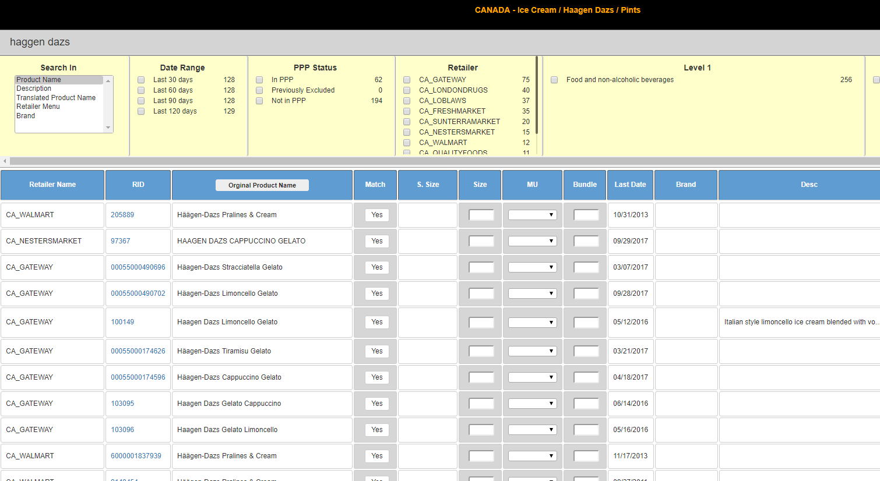
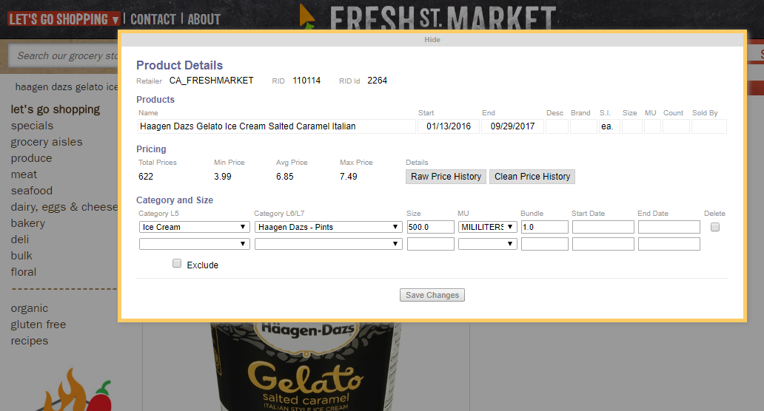
Matching Individual Products to Item definitions
We search the micro data in BPP for individual products that match item definition + enter product sizes
~100K products matched from 100 million available in the BPP databases for these 12 countries

Slide 7
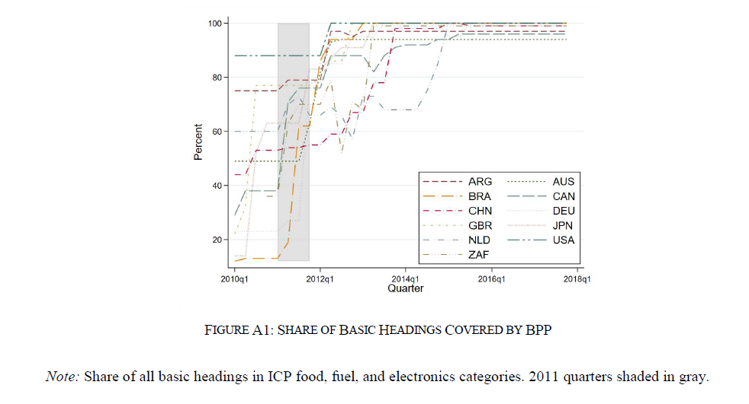
Many reasons to expect differences with ICP 2011
Item lists are similar but not identical
Temporal aggregation (quarterly vs yearly data)
Our matched-data coverage is not so good for 2011

Slide 8
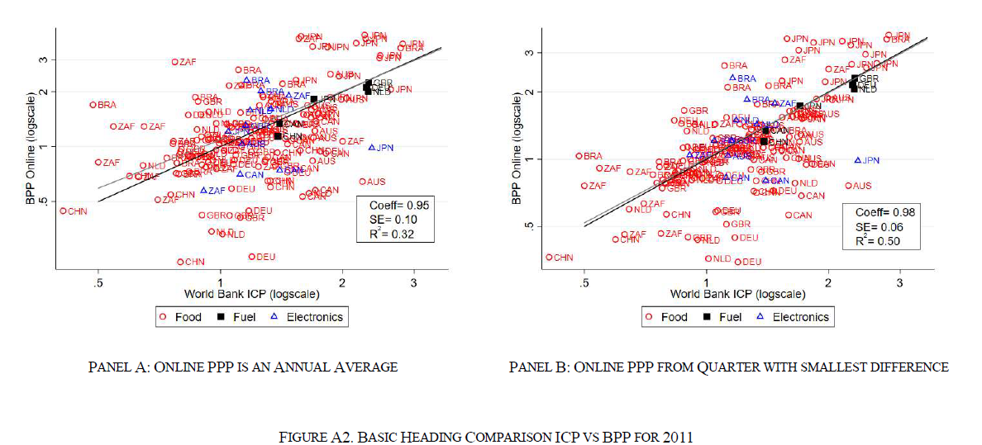
Basic Headings Price Levels (2011), relative to U.S.
Best when item definitions are the same as ICP’s (Fuel)
Better when a single quarter is used (we don’t know when ICP results where collected within the year)

Slide 9
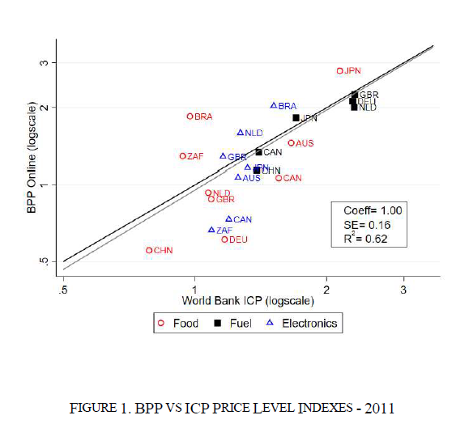
Sectors and Countries (2011)

Slide 10
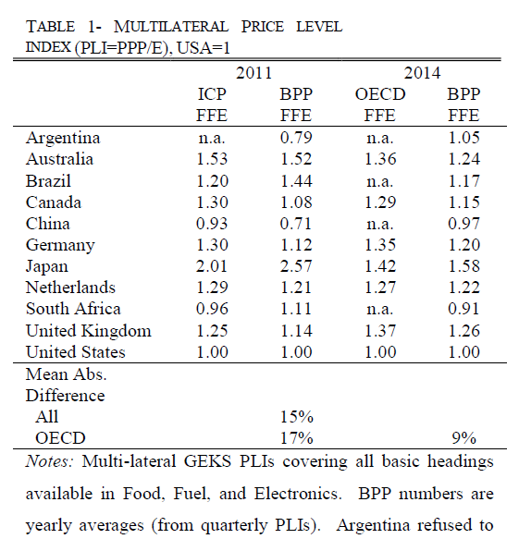
Multilateral Price Levels 2011 and 2014
Smaller differences in 2014, when online BH coverage is complete

Slide 11
Limitations
Few sectors and only 12 countries
BPP has some data for ~60
Online data still not available in many countries/regions
Online prices may not be representative of national averages
Though online-offline price differences are small within retailers (Cavallo, 2017)
Single price for all countries?
Many urban retailers with uniform pricing
Can be complemented by scraping smaller local retailers
No expenditure weights (same problem as in ICP)
Combine with scanner data?

Slide 12
Conclusions
Online data can provide prices in high-frequency, no delays, close similarity in products, more control and transparency in data collection and methods used. So BPP can possibly supplement (or replace) the very labor-intensive methods of the ICP.
Matching of individual products is still hard
Barcodes and product descriptions not standardized
Not simple to automate via machine learning
Besides retail products, what other prices are available?
Rental prices for housing
Wages for contract work
Other?

Slide 13
Additional Slides

Slide 14
Data Comparison with ICP

Slide 15
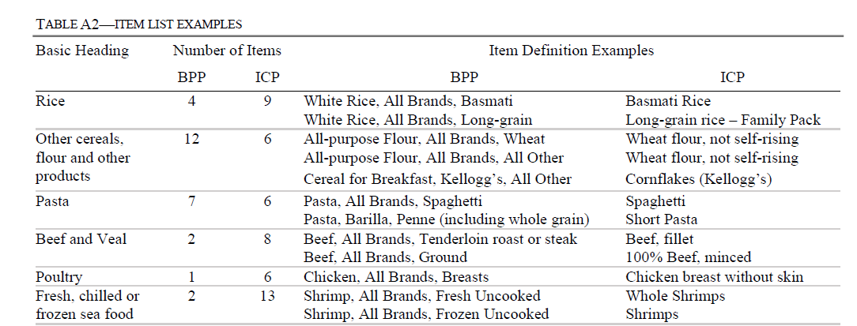
Item list

Slide 16
Note on Sales Taxes
Prices collected online include sales tax except for USA, Japan, Germany.
Current OPSLAC prices are being adjusted
USA → food = 0.9%, electronics 5.08%, Fuel includes tax (average sales tax for all states (unweighted) after taking into account food exceptions -source Federation of Tax Administrators Report 2015)
Germany → food taxed at 7%, the rest at 19%, fuel includes tax
Japan→ 5% before 3/2014, 8% after.

