Slide 1
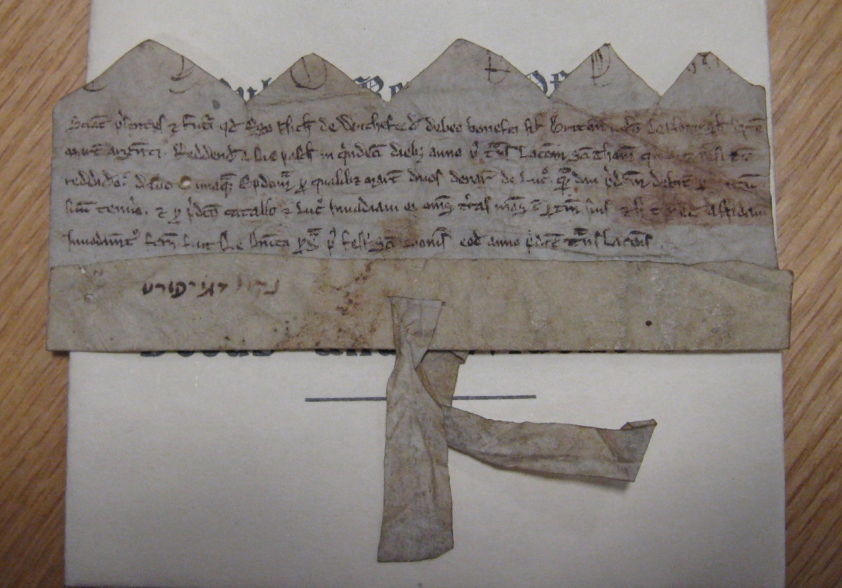
ChartEx: Discovering spatial descriptions and relationships in medieval charters
www.chartex.org
@ChartExProject

Slide 2
ChartEx Project Partners
University of York: History and Human Computer Interaction
University of Brighton: Natural Language Processing
University of Leiden: Data Mining
University of Washington: History, Web Services
University of Toronto: History and Digital Archives
Columbia University: History and Digital Libraries
Data Repositories: The National Archives (UK), Borthwick, DEEDS Project U of Toronto, Columbia Digital Humanities
Advisory Panel: various cognate projects

Slide 3
Digital Charter Collections
Charters of the Vicars Choral of York Minster. City of York and its suburbs to 1546. Latin charters and English translations.
The National Archives (UK) Ward 2. Abridged English translations
The Borthwick Institute, Yarburgh Muniments. Abridged English translations
DEEDS, University of Toronto. Latin charters of English provenance.
Cluny. Latin charters of French provenance

Slide 4
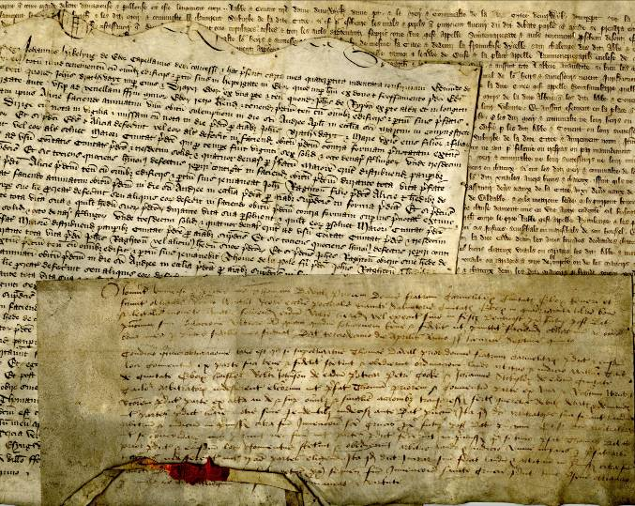
A charter from English Edition of
Vicars Choral collection
408. Grant by Thomas son of Josce goldsmith and citizen of York to his younger son Jeremy of half his land lying in length from Petergate at the churchyard of St. Peter to houses of the prebend of Ampleford and in breadth from Steyngate to land which mag. Simon de Evesham inhabited; paying Thomas and his heirs 1d. or [a pair of] white gloves worth 1 d. at Christmas. Warranty. Seal.
Witnesses: Geoffrey Gunwar, William de Gerford[b]y,' chaplains,Robert de Farnham, Robert le Spicer, John le plastrer, Walter de Alna goldsmith, Nicholas Page, Thomas talliator, Hugh le bedel, John de Glouc', clerks, and others.
January 1252

Slide 5
Chronological Sequencing and Spatial Sequencing
408. Grant by Thomas son of Josce goldsmith and citizen of York to his younger son Jeremy of half his land lying in length from Petergate at the churchyard of St. Peter to houses of the prebend of Ampleford and in breadth from Steyngate to land which mag. Simon de Evesham inhabited
409. Grant by Mariot widow of Thomas son of Josce goldsmith of York and by Jeremy (Jeremias) son of Thomas and Mariot to mag. Simon de Evesham canon of York of land with buildings in Steyngate, granted to them by Thomas, lying in length between Petergate and land of the prebend of Ampleford, and in breadth between Steyngate and land once of Geoffrey de Norwyz precentor of York

Slide 6

ChartEx Architecture
Analysed integrated
documents
Analysed individual
documents
Charter documents
Natural language processing
Data
mining
ChartEx workbench

Slide 7
The NLP Task
408. Grant by Thomas son of Josce goldsmith and citizen of York to his younger son Jeremy of half his land lying in length from Petergate at the churchyard of St. Peter to houses of the prebend of Ampleford and in breadth from Steyngate to land which mag. Simon de Evesham inhabited; paying Thomas and his heirs 1d. or [a pair of] white gloves worth 1 d. at Christmas. Warranty. Seal.
Get from a text like this …
Josce
1d every Christmas
father
Thomas
rent
from
occupation
… to some ‘semantic’ data like this
GRANT
father
goldsmith
subject
to
Jeremy
Land
length
breadth
Dimension1
Dimension2
from
to
from
to
Petergate
Ampleford
Steyngate
Simon’s land

Slide 8
The NLP Task
408. Grant by Thomas son of Josce goldsmith and citizen of York to his younger son Jeremy of half his land lying in length from Petergate at the churchyard of St. Peter to houses of the prebend of Ampleford and in breadth from Steyngate to land which mag. Simon de Evesham inhabited; paying Thomas and his heirs 1d. or [a pair of] white gloves worth 1 d. at Christmas. Warranty. Seal.
Get from a text like this …
  T1 Document 0 17 vicars-choral-387
  T2 Transaction 18 23 Grant
  T3 Person 27 34 William
  T4 Institution 73 90 prebend of Masham
  T5 Person 42 49 Richard
  T6 Occupation 51 64 canon of York
  …
  R3 is_son_of Arg1:T3 Arg2:T5
  R4 is_grantor_in Arg1:T3 Arg2:T2
  R5 occupation_is Arg1:T3 Arg2:T6
… actually it looks more like this
(BRAT markup)
(http://brat.nlplab.org/)

Slide 9
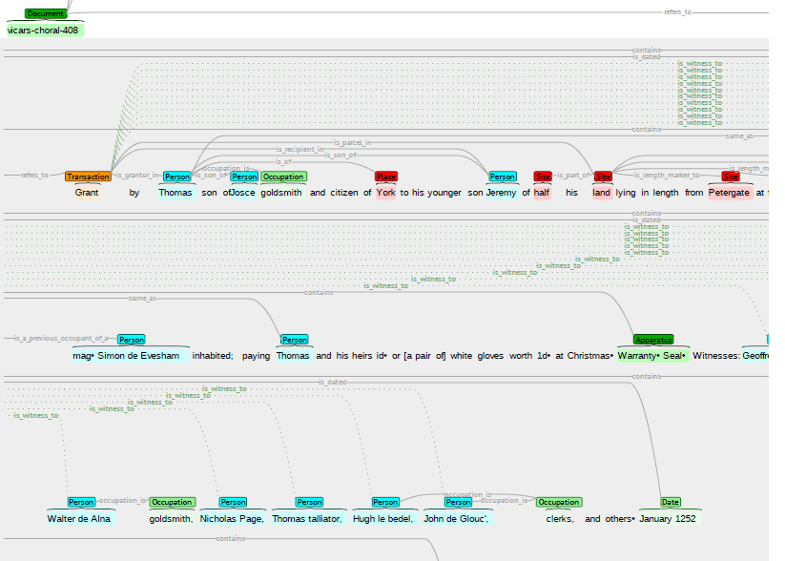
The NLP Task
408. Grant by Thomas son of Josce goldsmith and citizen of York to his younger son Jeremy of half his land lying in length from Petergate at the churchyard of St. Peter to houses of the prebend of Ampleford and in breadth from Steyngate to land which mag. Simon de Evesham inhabited; paying Thomas and his heirs 1d. or [a pair of] white gloves worth 1 d. at Christmas. Warranty. Seal.
Get from a text like this …
… which we can view and edit like this
(using BRAT)
(http://brat.nlplab.org/)

Slide 10
NLP development methodology
Step 1 – find out what the mark up should be
Step 2 – ask historians to mark up some documents manually
Step 3 – use some of these examples to develop system
Step 4 – use the rest to evaluate performance

Slide 11
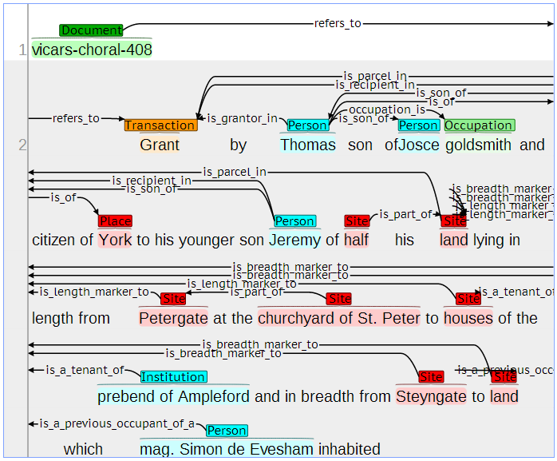
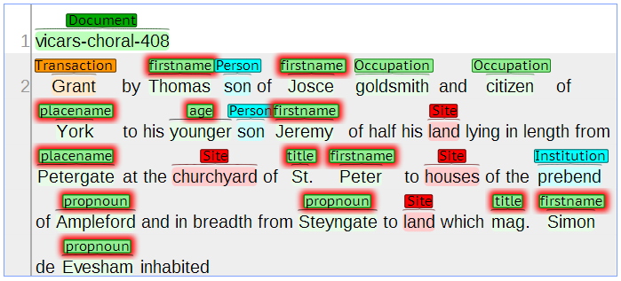
NLP – layered pattern matching
Grant by Thomas son of Josce goldsmith and citizen of York to his younger son Jeremy of half his land lying in length from Petergate at the churchyard of St. Peter to houses of the prebend of Ampleford and in breadth from Steyngate to land which mag. Simon de Evesham inhabited;
Reference annotation
NLP annotation
Token layer: identify semantic types and intrinsic properties (eg gender) of known individual words (not all of these feature in final output).

Slide 12
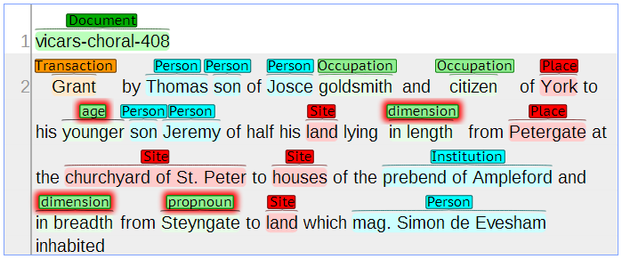
NLP – layered pattern matching
Grant by Thomas son of Josce goldsmith and citizen of York to his younger son Jeremy of half his land lying in length from Petergate at the churchyard of St. Peter to houses of the prebend of Ampleford and in breadth from Steyngate to land which mag. Simon de Evesham inhabited;
Reference annotation
NLP annotation
Lexical layer: identify simple lexical phrases – groups of tokens that act as individual units. Promote other tokens to lexical items.

Slide 13
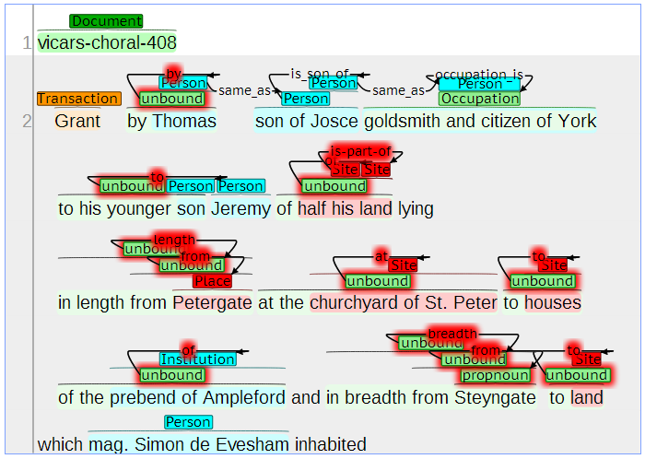
NLP – layered pattern matching
Grant by Thomas son of Josce goldsmith and citizen of York to his younger son Jeremy of half his land lying in length from Petergate at the churchyard of St. Peter to houses of the prebend of Ampleford and in breadth from Steyngate to land which mag. Simon de Evesham inhabited;
Reference annotation
NLP annotation
Phrasal layer: use part-of-speech tags to build lexical items into local syntactic/semantic structures

Slide 14
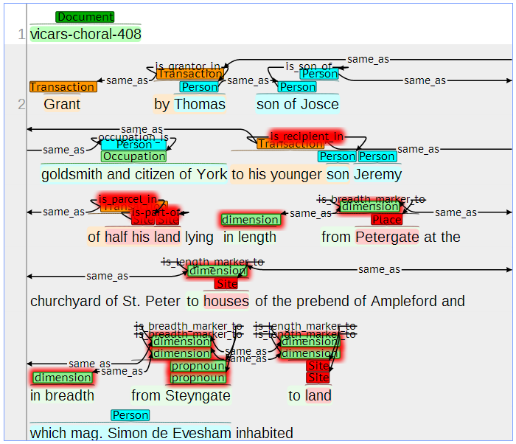
NLP – layered pattern matching
Grant by Thomas son of Josce goldsmith and citizen of York to his younger son Jeremy of half his land lying in length from Petergate at the churchyard of St. Peter to houses of the prebend of Ampleford and in breadth from Steyngate to land which mag. Simon de Evesham inhabited;
Reference annotation
NLP annotation
Semantic layer: build semantic relationships from syntactic phrases

Slide 15
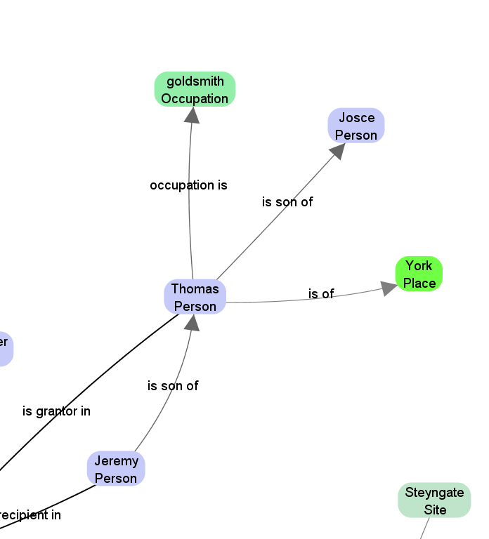
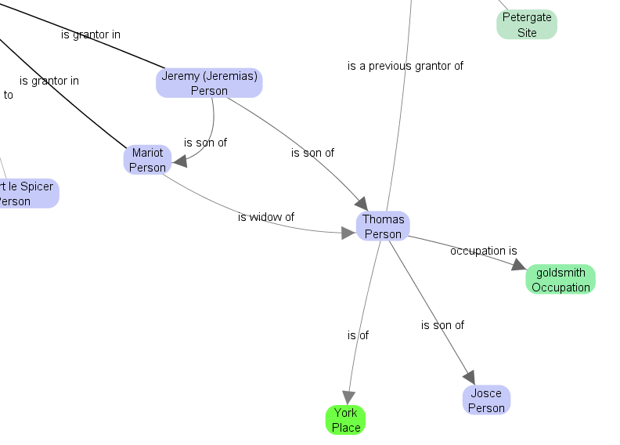
Matching Relational Information
Vicars Choral 408
Vicars Choral 409

Slide 16
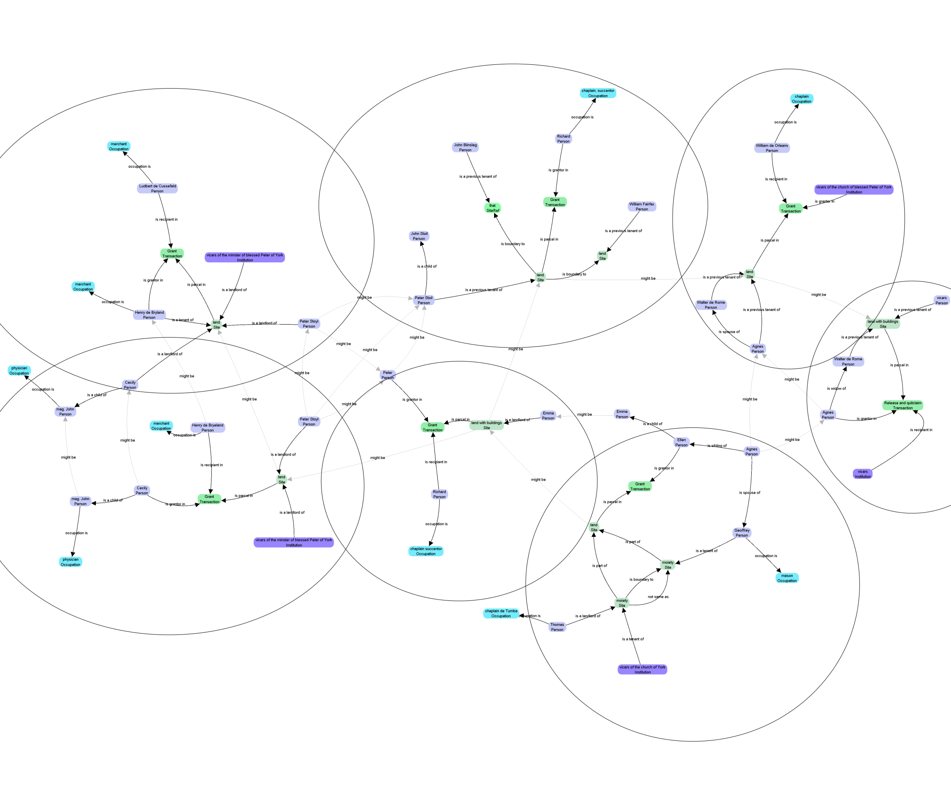
Networks of People

Slide 17
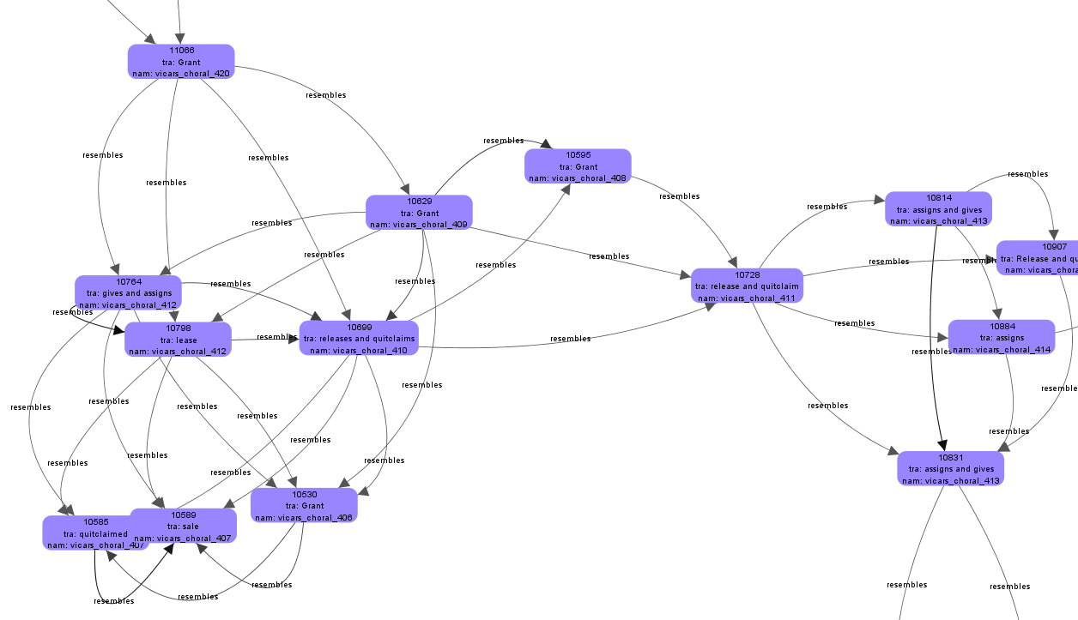
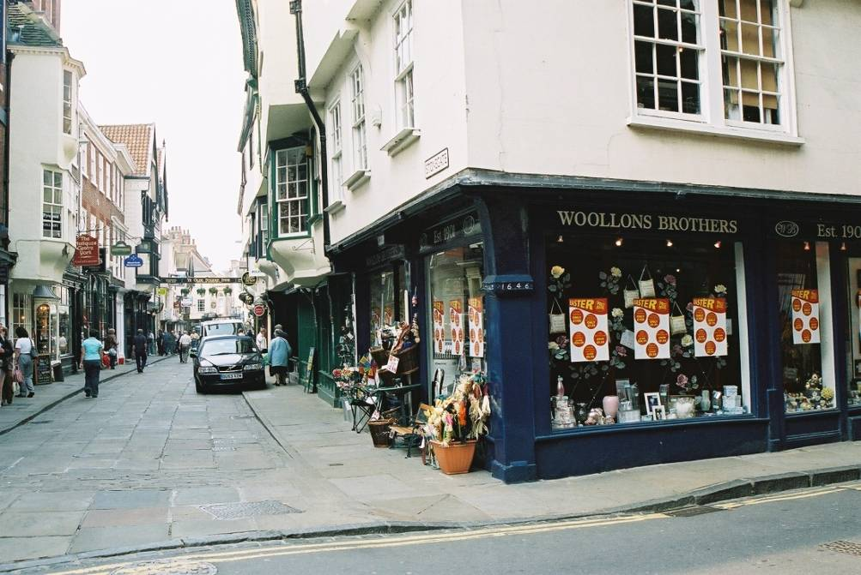
Charter Networks
corner
Steyngate/Petergate
third property
on Petergate

Slide 18
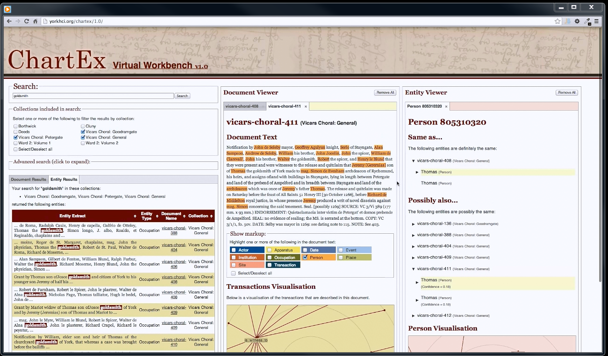
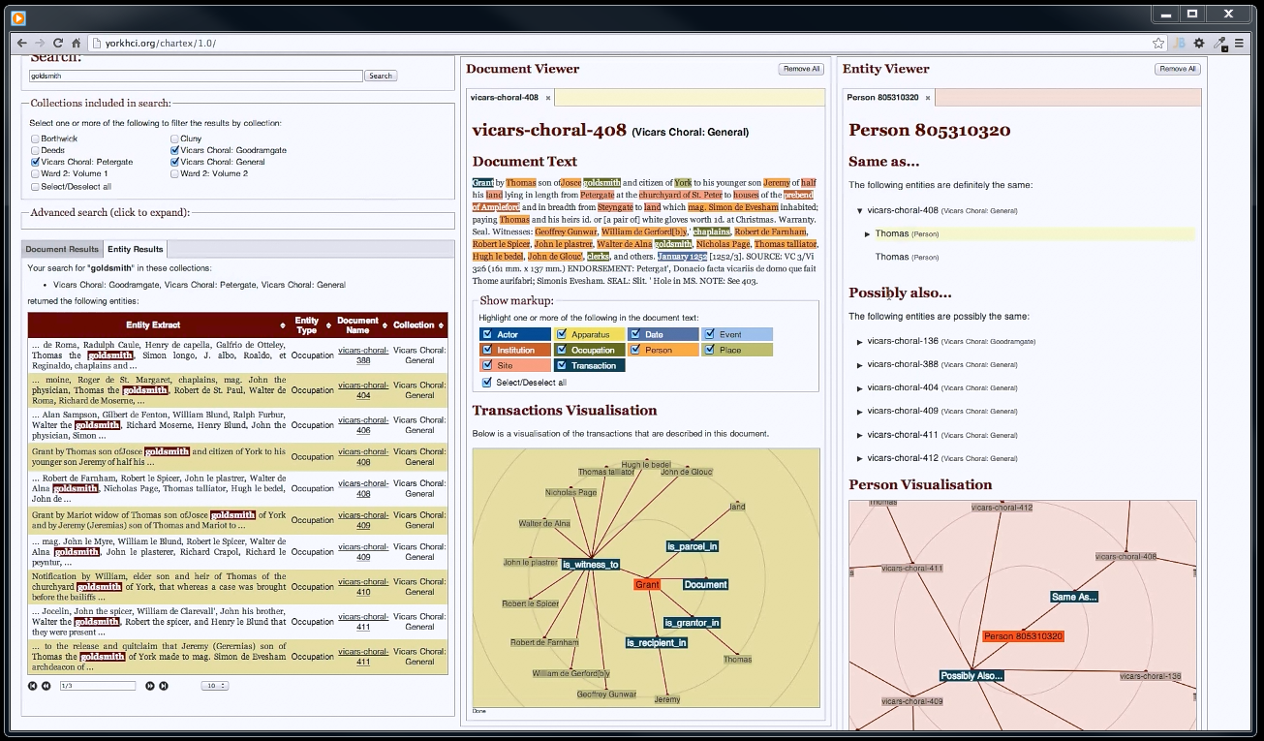
The ChartEx Virtual Workbench
A video presentation of the workbench is available on the ChartEx website at: http://www.chartex.org/docs/Chartex-Montreal-12102013-VIDEO.mov

Slide 19
Next Steps
Final integration and evaluations
Fall/Autumn 2013 (sessions in York and in New York, week of 4 – 8 November)
Dissemination
Not just Digital Humanities (eg novel NLP approach)
Impact
National and regional archives in the UK
Commercial applications?
Follow-on funding
Several bids building on ChartEx submitted

Slide 20
ChartEx: Discovering spatial descriptions and relationships in medieval charters
www.chartex.org
@ChartExProject

