Slide 1











Digging into Human Rights Violations:
Anaphora Resolution and Emergent Witnesses
Project Team | Partners & Advisors
Ben Miller¹ Lu Xiao² Karthikeyan Umapathy³ George Pullman¹ Steven High⁵ Ayush Shrestha¹ Lindsay Baker² Jillian R. Kavanaugh² Fuxin Li⁴ Isioma Eluenze² Jennifer Olive¹ Tatiana Lukoianova² Yan Luo² Mary Beth Rosson⁹ Agnes Sandor⁸ Xueheng (Vicky) Yan² Yanjun Zhao¹ Nicholas Subtirelu¹ Kristopher Kyle¹ Jin Zhao¹ | Human Rights Data Analysis Group Benetech Resolve Invisible Children Nancy Marrelli⁵ Ben Kiernan⁶ Dan Jurafsky⁷
Georgia State University¹, Western University², University of North Florida³, Georgia Institute of Technology⁴, Concordia University⁵, Yale University⁶, Stanford University⁷, Xerox Research Centre Europe ⁸, EUSES Consortium⁹

Slide 2

Research Context
Data Availability: preserving and making data available to public
Examples:
  Duke Human Rights Archive
  Human Rights Documentation Initiative (HRDI) at the University of Texas at Austin
  Iran Human Rights Documentation Center
  Center for Human Rights Documentation and Research at Columbia University
Technology Availability
  Text data mining
  Natural Language Processing
  Data visualization
  Visual analytical tools
A User-Centered Approach in Developing Visual Analytical Tools for Analyzing “Big Data” in Human Rights Research

Slide 3
Support Analysis of Big Textual Data – User-Centred Development
Requirement Analysis
Root Concept
what is
wanted
scenarios
task analysis
Iterative Design
guidelines
principles
analysis
Interviews
Ethnography
what is there
vs.
what is wanted
design
precise
specification
dialogue
notations
implement
and deploy
evaluation
heuristics
prototype
architectures
documentation
help

Slide 4
Requirements Analysis
Understand the users’ current data analysis situation, and expectation and concerns on the new analysis programs
Qualitative analysis of human rights research literature
Semi-Structured Interview and Questionnaire
Review of Seven Data Analysis Programs in Human Rights Research

Slide 5
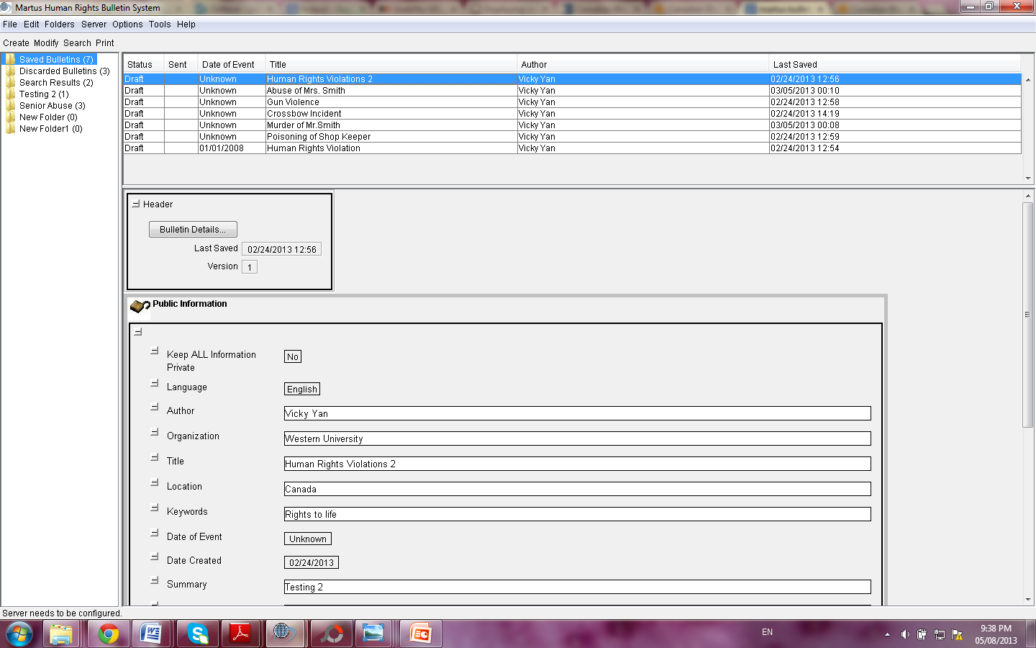
Iterative User Interface (UI) Design
Design of Martus User Interfaces to integrate data visualization feature into Martus system
  Martus system (https://www.martus.org/):

Slide 6
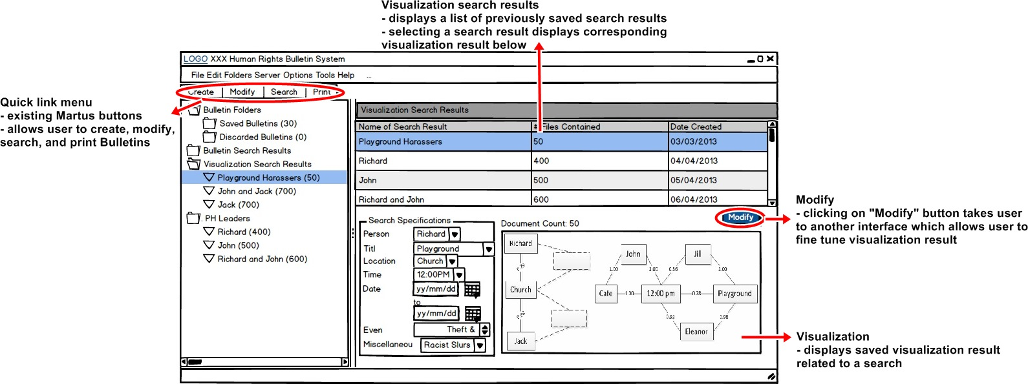
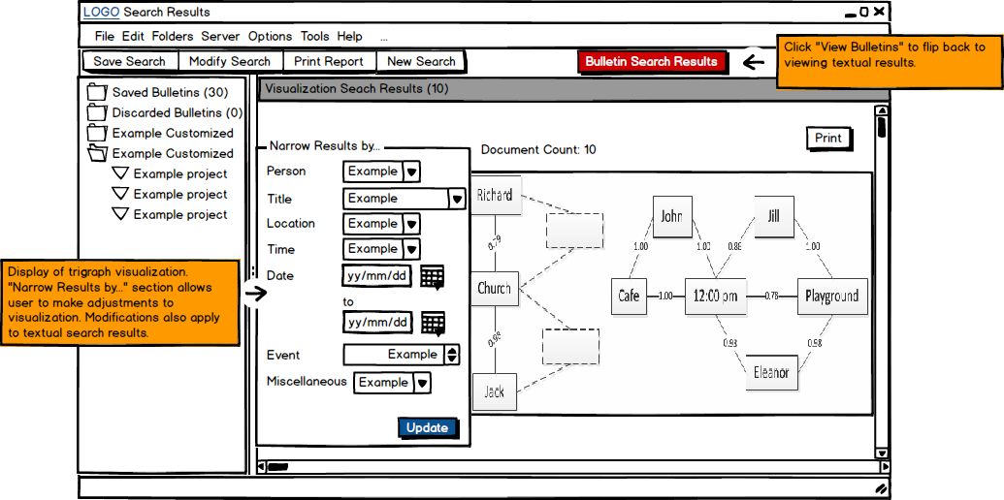
Iterative UI Design
Formative Evaluation – Six users; cooperative evaluation session
Presented and Delivered to Benetech

Slide 7

Our User-Centered Development Focus
Requirements Analysis
Iterative UI Design
Participatory Design Approach in Developing a Collaborative Visual Analytical Tool for Stories Matter Collections

Slide 8
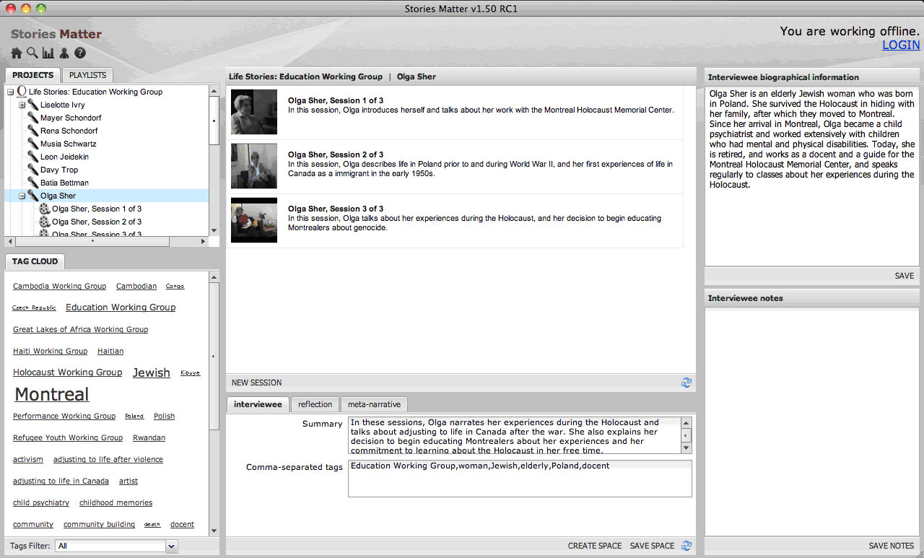
  Stories Matter – Concordia University, Centre for Oral History and Digital Storytelling: http://storytelling.concordia.ca/storiesmatter/

Slide 9
Our Technical Solution
Data Mining/Natural Language Processing
Interactive Visual Analytics; Collaborative Computing
Our Participatory Design Approach …

Slide 10
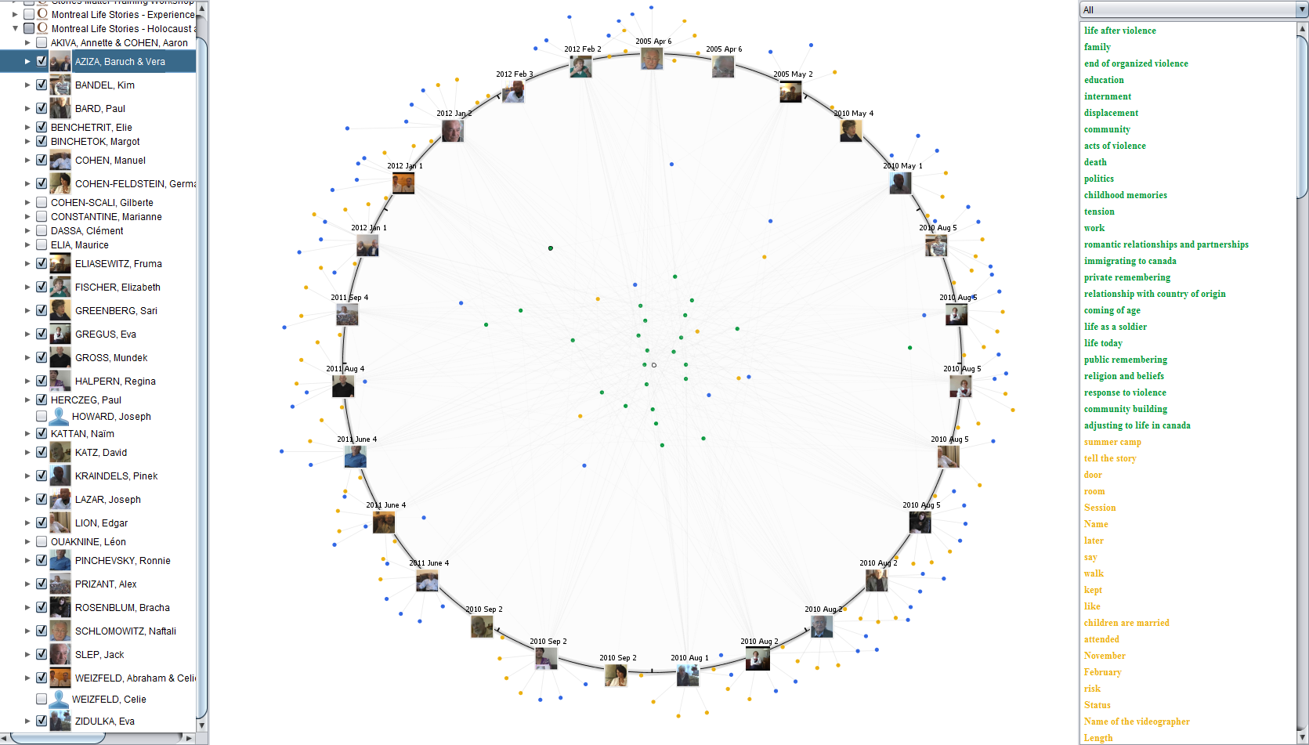
Keyphrases Map Visualization
Determine
Node Position
Key phrases list
Entity selection

Slide 11
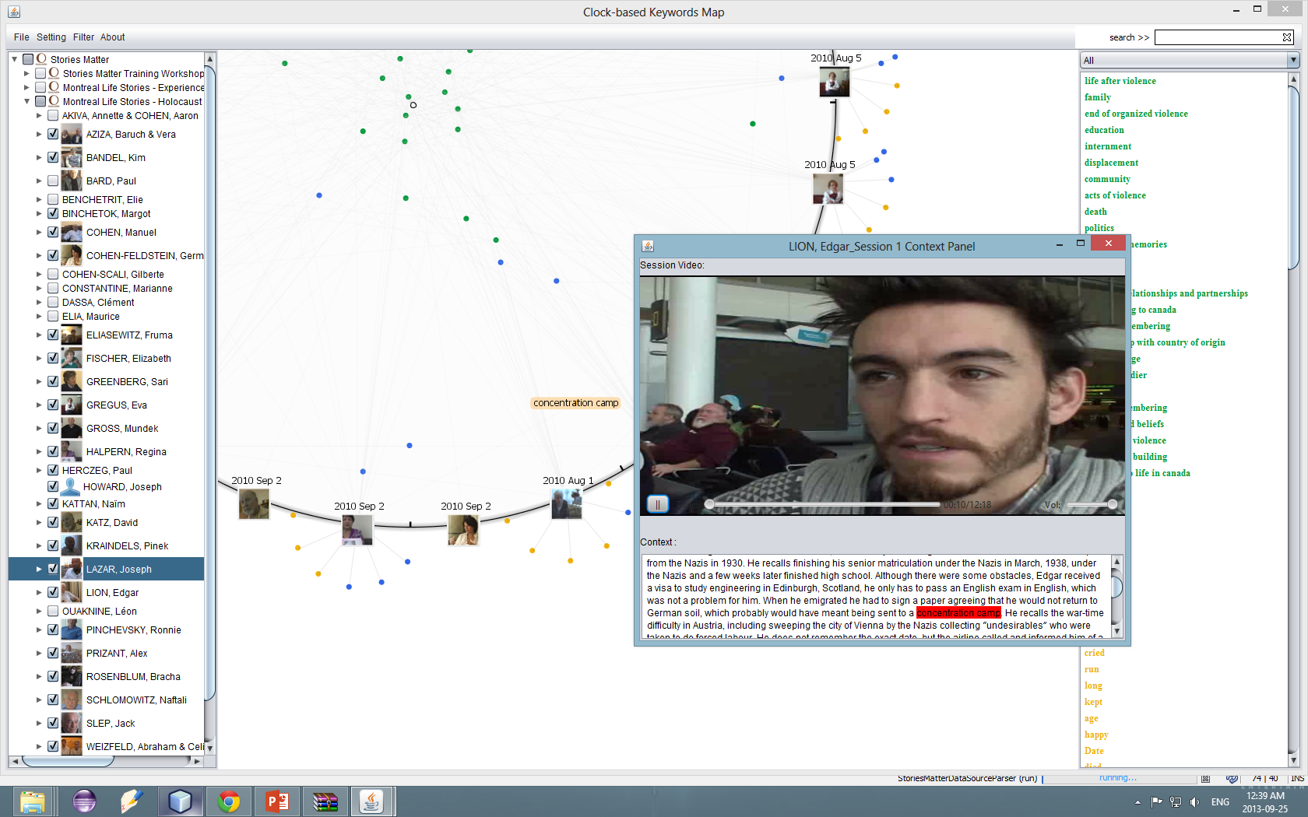
Notes:
Highlighting
Zoom and Pan
Filtering and Reconfiguration
Context Navigation
Collaborative Annotation and Feedback
----- Meeting Notes (13-10-11 17:03) -----
integrating the text with the interviews
Projects: diverse experiences
life story interview - common theme (life course) that is what unites all the projects
coded key things such as mass violence
core mapping across the projects - georgraphy - biographical mapping; mapping at different scale;
all the women; all the men; age; interviewer; -- filters on the left navigation panel,
collaborative space - my exploration can be viewed by others
kinds of acts
browse through the interviews vs.
analyze the collections
Highlighting
Zoom and Pan
Filtering and Reconfiguration
Context Navigation
Collaborative Annotation and Feedback

Slide 12
YouTube video of the Keyphrases Map

Slide 13
Supporting Big Data Analysis
Collaborative Visual Analytical Tool
Information Retrieval
Pattern Identification
Information Sharing
Collaboration Support
Our Methodology: User-Centered Development and User Experience Research
Notes:
Information Retrieval
How to quickly access and retrieve the desired information?
Pattern Identification
What are the shared point of views or content among different interviewees?
How do the topics of interviews evolve in a project?
Information Sharing
How to support the sharing of information related to Stories Matter data among the researchers?
How to support the sharing of analysis process with Stories Matter data among the researchers?
Our Challenges
Information extraction
Pattern identification and representation
Interacting with the information
Sharing big data analysis process and collaboration around big data
Our User-centered development approach
Requirements Analysis
Iterative User Interface Design
Participatory Design of an Interactive Visual Analytical Tool

Slide 14
Acknowledgement
Interview and questionnaire participants; Kim Moore and Eve-Lyne Cayouette Ashby
Project Members: Lindsay Baker, Isioma Eluenze
Steven High, Jillian R. Kavanaugh, Tatiana Lukoianova, Yan Luo, Mary Beth Rosson, Agnes Sandor, Xueheng (Vicky) Yan
Notes:
----- Meeting Notes (13-10-11 17:03) -----
Cheryl - Stories Matter

Slide 15
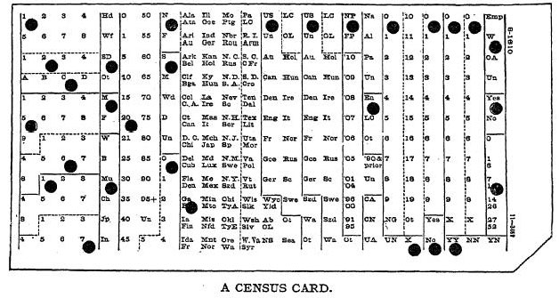
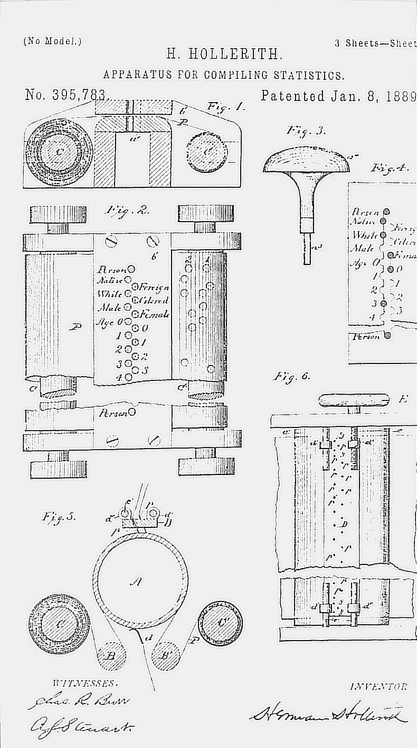
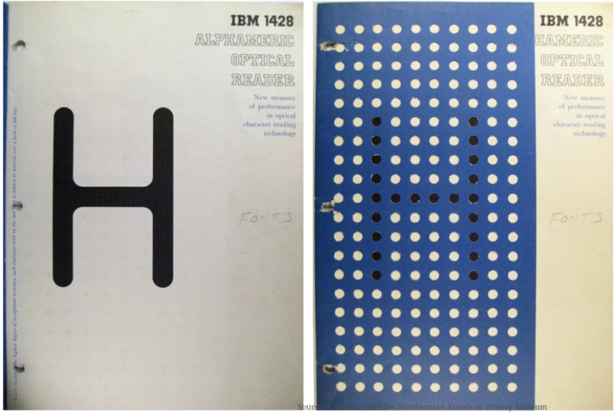
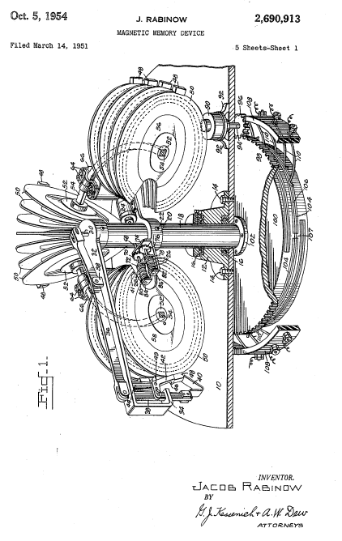
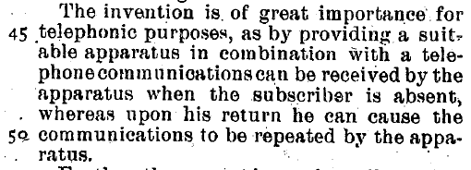
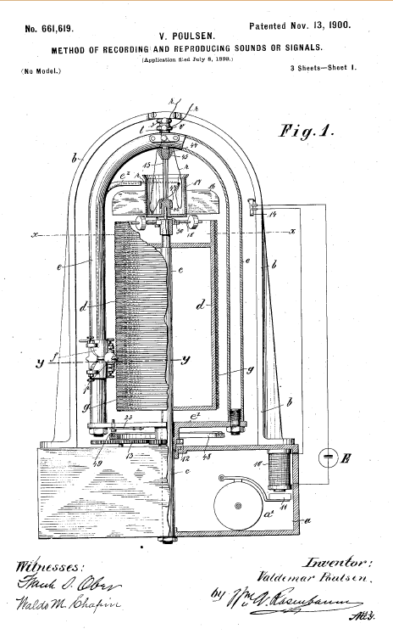
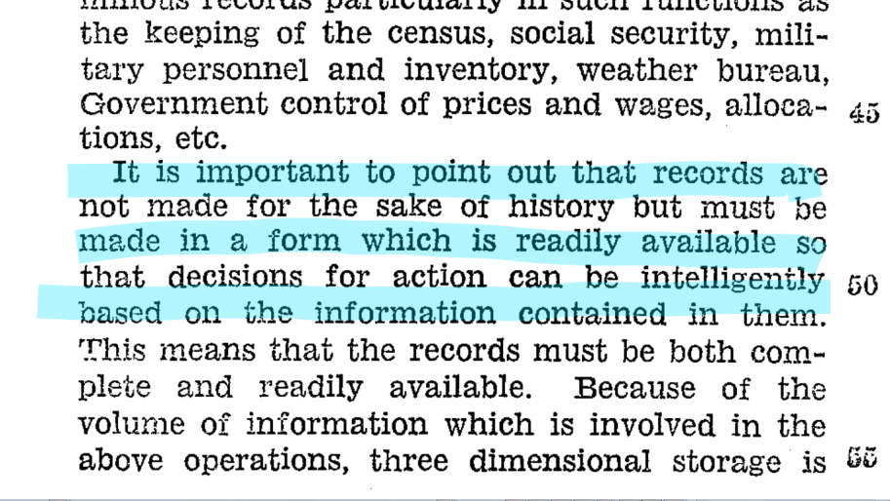
I. Context & Challenge
Human rights violations information is buried in heterogeneous natural language produced during and after events of interest by victims, perpetrators, witnesses, and analysts.
The data is stored in a variety of platforms, systems, languages, and formats.
Witness recall and memories of trauma are highly problematic with regard to chronology, veridicality, and spatiality.
Natural storytelling is highly referential, ambiguous, varied, and underspecified, providing few absolute or consistent markers of identity, location, time, or violation.
Manually correlating evidence across reports from multiple witnesses doesn’t scale.
Anaphora resolution, entity resolution, and cross-document coreference are hard.
Source: NARA
Sources: US Patent 395793
Source: Smithsonian Lemelson Archive,
Source: US. Patent 2,690,913
Source: US Patent 661,619

Slide 16
I. Desired analytic outcomes
quantify the scope or frequency of violations so as to make determinations of the presence and character of a violation pattern
determine emerging patterns of violations and assess possible interventions
study the generalizability of a given records collection in relation to a violation context
correlate evidence for truth and reconciliation or prosecutorial efforts
tell the history of an event, for the assuaging of public memory, for the scholarly record, or for the prosecution of suspected violators.
Source: NARA
Sources: US Patent 395793
Source: Smithsonian Lemelson Archive,
Source: US. Patent 2,690,913
Source: US Patent 661,619

Slide 17
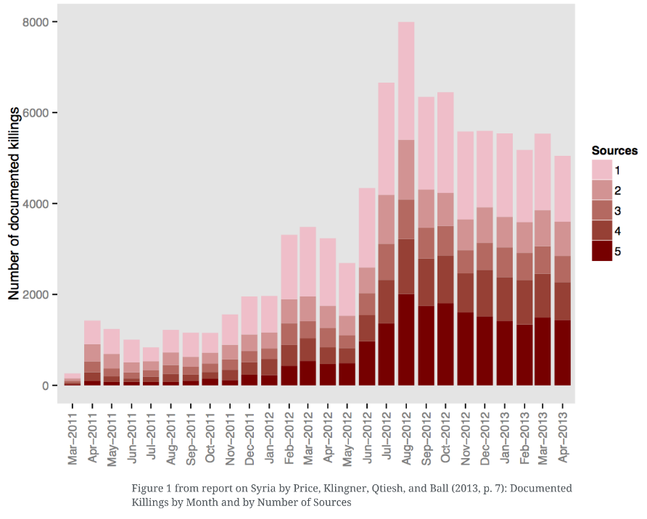
II. Predicates & Material Histories

Slide 18
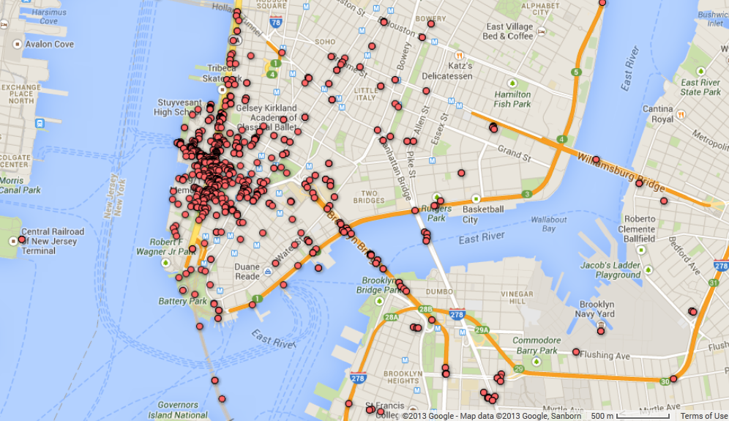
III. Testing Corpora and Examples
Types of data:
Interviews, transcripts, and bulletins in txt, csv, xml, htm, doc, dbf, sql, and pdf
Examples of data:
World Trade Center Task Force Interview Database: 511 interviews, 1.3m words
South Africa Truth and Reconciliation Commission: subset of 22,000 interviews, 5 years worth of trial transcripts
Lord’s Resistance Army: heterogeneous documentation pertaining to the LRA’s estimated 10k abductions, 500k displacements, and many thousand violations of right to life
Various other similar datasets describing mass violations in Africa,
South East Asia, and South America
File No. 9110052
WORLD TRADE CENTER TASK FORCE INTERVIEW FIREFIGHTER ARTHUR M.
Interview Date: October 11, 2001
Q: So you were past Vesey.
A: Past Vesey.
Q: Past the pedestrian overpass.
A: Past Vesey but right in this section here because this is the north tower here, I can see the front entrance to the north tower. So I must be somewhere down in here. Now the guys are gone. I'm looking. I see what I just couldn't believe. I thought it was a big doll baby, but these were burnt people falling. Right after that then you see live people jumping. This is the first time I've ever seen people jump like this in my whole career.
Q: 20 years.
A: In 20 years, this is the first time I've ever witnessed this, and it was just blowing my mind. The chauffeur from 3 Engine, he was telling me, listen, don't look, just don't -- I said, "How can I not look? I've never seen this before." Just any time you thought that would be it, then you'd see more waves of people coming. It was like raining people. You could hear when they hit the ground, bang, bang, and the body parts just dismantling all over the place. At that time it just got to me. I turned around to look away from it, and I'm saying to myself these are people. Man, there are people dying here. I couldn't believe what I was seeing.

Slide 19
IV. Extraction
Phrase level LSA with a sliding window for text size
Recognition of level of uncertainty of a given dyad
Focused LSA for rights violations

Slide 20
IV. Extraction
Interview | Person | Scene | globalEvent | Time | Interval | Location
460 | Thomas Orlando | 5 | Second Plane Hits | 9:03:02 | 0:17:04 | 18th Floor of 1 World Trade Center
460 | Officer for Engine 65 | 6 |  | 9:20:06 | 0:17:04 | 18th Floor of 1 World Trade Center
460 | Chief running up stairs | 6 |  | 9:20:06 | 0:00:00 | 18th Floor of 1 World Trade Center
460 | Josephine, lady that 6 Truck helped | 6 |  | 9:20:06 | 0:00:00 | 18th Floor of 1 World Trade Center
460 | Captain Freddie Ill | 6 |  | 9:20:06 | 0:00:00 | 13th Floor of 1 World Trade Center
460 | Thomas Orlando | 7 |  | 9:37:10 | 0:17:04 | Lobby in 1 World Trade Center
460 | Officer for Engine 65 | 7 |  | 9:37:10 | 0:00:00 | Lobby in 1 World Trade Center
460 | Firefighter from 4 Truck | 7 |  | 9:37:10 | 0:00:00 | Lobby in 1 World Trade Center
460 | Firefighter from 4 Truck | 7 |  | 9:37:10 | 0:00:00 | Stairwell in 1 World Trade Center
460 | Thomas Orlando | 8 |  | 9:54:14 | 0:17:04 | West Street
460 | Officer for Engine 65 | 8 |  | 9:54:14 | 0:00:00 | West Street
460 | Chief Al Turi | 8 |  | 9:54:14 | 0:00:00 | West Street
460 | Thomas Orlando | 9 |  | 10:11:18 | 0:17:04 | Bridge on West St
460 | Officer for Engine 65 | 9 |  | 10:11:18 | 0:00:00 | Bridge on West St
460 | Officer for Engine 65 | 9.1 |  | 10:28:22 | 0:17:04 | Vesey and West St
460 | Thomas Orlando | 10 | Tower 1 collapses | 10:28:22 |  | North on West St
471 | Jason Charles | 5 | Second Plane Hits | 9:03:02 | 0:02:26 | West side of 6th Ave at 28th St
471 | Jason Charles' Son, 3 years old | 5 |  | 9:03:02 | 0:00:00 | West side of 6th Ave at 28th St
471 | Jason Charles | 6 |  | 9:05:28 | 0:02:26 | 28th st and 2nd ave
471 | Jason Charles' Son, 3 years old | 6 |  | 9:05:28 | 0:00:00 | 28th st and 2nd ave
471 | Jason Charles | 7 |  | 9:07:54 | 0:02:26 | 27th St. and 2nd Ave
471 | Jason Charles | 8 |  | 9:10:20 | 0:02:26 | 2nd Ave
471 | An engine truck | 8 |  | 9:10:20 | 0:00:00 | 2nd Ave
471 | Jason Charles | 9 |  | 9:12:46 | 0:02:26 | 2nd Ave at 23rd St
471 | ESU Truck | 9 |  | 9:12:46 | 0:00:00 | 2nd Ave at 23rd St
471 | Jason Charles | 10 |  | 9:15:12 | 0:02:26 | 2nd ave at 21st st
471 | Cop standing next to barricades | 10 |  | 9:15:12 | 0:00:00 | 2nd ave at 21st st
471 | Jason Charles | 11 |  | 9:17:38 | 0:02:26 | 2nd ave at 15th st
471 | Jason Charles | 12 |  | 9:20:04 | 0:02:26 | 2nd ave at 14th st
471 | ESU Truck | 12 |  | 9:20:04 | 0:00:00 | 3rd ave at 14th st
471 | three FDNY Ambulances | 12 |  | 9:20:04 | 0:00:00 | 4th ave at 14th st
…
471 | Metro Care Ambulance | 12 |  | 9:20:04 | 0:00:00 | 5th ave at 14th st
471 | Jason Charles | 19 |  | 9:37:05 | 0:02:26 | Dey between Broadway and Fulton
471 | Jason Charles | 20 |  | 9:39:31 | 0:02:26 | Dey and Broadway
471 | FBI agents | 25 |  | 9:51:41 | 0:00:00 | Fulton and Church Street
…
471 | jason Charles | 26 |  | 9:54:07 | 0:02:26 | Dey and Broadway
471 | 9 EMTs | 26 |  | 9:54:07 | 0:00:00 | Dey and Broadway
471 | two paramedics | 26 |  | 9:54:07 | 0:00:00 | Dey and Broadway
471 | three EMTs | 26 |  | 9:54:07 | 0:00:00 | Fulton and Church Street
471 | Jason Charles | 27 |  | 9:56:33 | 0:02:26 | Fulton and Church Street
471 | female Lieutenant from Battalion 4 | 27 |  | 9:56:33 | 0:00:00 | Fulton and Church Street
471 | Batallion 4 Medic | 27 |  | 9:56:33 | 0:00:00 | Fulton and Church Street
471 | Batallion 4 Medic | 27 |  | 9:56:33 | 0:00:00 | Dey and Church
471 | EMTs from Brooklyn | 27 |  | 9:56:33 | 0:00:00 | Fulton and Church Street
471 | EMTs from Quuens | 27 |  | 9:56:33 | 0:00:00 | Fulton and Church Street
471 | Heavyset Lady | 27 |  | 9:56:33 | 0:00:00 | Fulton and Church Street
471 | male Lieutenant talking | 28 | Tower 2 collapses | 9:58:59 |  | Fulton and Church Street

Slide 21
IV. Extraction
Interview | Person | Scene | globalEvent | Time | Interval | Location
460 | Thomas Orlando | 5 | Second Plane Hits | 9:03:02 | 0:17:04 | 18th Floor of 1 World Trade Center
460 | Officer for Engine 65 | 6 |  | 9:20:06 | 0:17:04 | 18th Floor of 1 World Trade Center
460 | Chief running up stairs | 6 |  | 9:20:06 | 0:00:00 | 18th Floor of 1 World Trade Center
460 | Josephine, lady that 6 Truck helped | 6 |  | 9:20:06 | 0:00:00 | 18th Floor of 1 World Trade Center
460 | Captain Freddie Ill | 6 |  | 9:20:06 | 0:00:00 | 13th Floor of 1 World Trade Center
460 | Thomas Orlando | 7 |  | 9:37:10 | 0:17:04 | Lobby in 1 World Trade Center
460 | Officer for Engine 65 | 7 |  | 9:37:10 | 0:00:00 | Lobby in 1 World Trade Center
460 | Firefighter from 4 Truck | 7 |  | 9:37:10 | 0:00:00 | Lobby in 1 World Trade Center
460 | Firefighter from 4 Truck | 7 |  | 9:37:10 | 0:00:00 | Stairwell in 1 World Trade Center
460 | Thomas Orlando | 8 |  | 9:54:14 | 0:17:04 | West Street
460 | Officer for Engine 65 | 8 |  | 9:54:14 | 0:00:00 | West Street
460 | Chief Al Turi | 8 |  | 9:54:14 | 0:00:00 | West Street
460 | Thomas Orlando | 9 |  | 10:11:18 | 0:17:04 | Bridge on West St
460 | Officer for Engine 65 | 9 |  | 10:11:18 | 0:00:00 | Bridge on West St
460 | Officer for Engine 65 | 9.1 |  | 10:28:22 | 0:17:04 | Vesey and West St
460 | Thomas Orlando | 10 | Tower 1 collapses | 10:28:22 |  | North on West St
471 | Jason Charles | 5 | Second Plane Hits | 9:03:02 | 0:02:26 | West side of 6th Ave at 28th St
471 | Jason Charles' Son, 3 years old | 5 |  | 9:03:02 | 0:00:00 | West side of 6th Ave at 28th St
471 | Jason Charles | 6 |  | 9:05:28 | 0:02:26 | 28th st and 2nd ave
471 | Jason Charles' Son, 3 years old | 6 |  | 9:05:28 | 0:00:00 | 28th st and 2nd ave
471 | Jason Charles | 7 |  | 9:07:54 | 0:02:26 | 27th St. and 2nd Ave
471 | Jason Charles | 8 |  | 9:10:20 | 0:02:26 | 2nd Ave
471 | An engine truck | 8 |  | 9:10:20 | 0:00:00 | 2nd Ave
471 | Jason Charles | 9 |  | 9:12:46 | 0:02:26 | 2nd Ave at 23rd St
471 | ESU Truck | 9 |  | 9:12:46 | 0:00:00 | 2nd Ave at 23rd St
471 | Jason Charles | 10 |  | 9:15:12 | 0:02:26 | 2nd ave at 21st st
471 | Cop standing next to barricades | 10 |  | 9:15:12 | 0:00:00 | 2nd ave at 21st st
471 | Jason Charles | 11 |  | 9:17:38 | 0:02:26 | 2nd ave at 15th st
471 | Jason Charles | 12 |  | 9:20:04 | 0:02:26 | 2nd ave at 14th st
471 | ESU Truck | 12 |  | 9:20:04 | 0:00:00 | 3rd ave at 14th st
471 | three FDNY Ambulances | 12 |  | 9:20:04 | 0:00:00 | 4th ave at 14th st
…
471 | Metro Care Ambulance | 12 |  | 9:20:04 | 0:00:00 | 5th ave at 14th st
471 | Jason Charles | 19 |  | 9:37:05 | 0:02:26 | Dey between Broadway and Fulton
471 | Jason Charles | 20 |  | 9:39:31 | 0:02:26 | Dey and Broadway
471 | FBI agents | 25 |  | 9:51:41 | 0:00:00 | Fulton and Church Street
…
471 | jason Charles | 26 |  | 9:54:07 | 0:02:26 | Dey and Broadway
471 | 9 EMTs | 26 |  | 9:54:07 | 0:00:00 | Dey and Broadway
471 | two paramedics | 26 |  | 9:54:07 | 0:00:00 | Dey and Broadway
471 | three EMTs | 26 |  | 9:54:07 | 0:00:00 | Fulton and Church Street
471 | Jason Charles | 27 |  | 9:56:33 | 0:02:26 | Fulton and Church Street
471 | female Lieutenant from Battalion 4 | 27 |  | 9:56:33 | 0:00:00 | Fulton and Church Street
471 | Batallion 4 Medic | 27 |  | 9:56:33 | 0:00:00 | Fulton and Church Street
471 | Batallion 4 Medic | 27 |  | 9:56:33 | 0:00:00 | Dey and Church
471 | EMTs from Brooklyn | 27 |  | 9:56:33 | 0:00:00 | Fulton and Church Street
471 | EMTs from Quuens | 27 |  | 9:56:33 | 0:00:00 | Fulton and Church Street
471 | Heavyset Lady | 27 |  | 9:56:33 | 0:00:00 | Fulton and Church Street
471 | male Lieutenant talking | 28 | Tower 2 collapses | 9:58:59 |  | Fulton and Church Street
Interview | Person | Scene | Time | Location | GPS
460 | Josephine, that lady that 6 Truck helped | 6 | 9:20:06 | 18th Floor of 1 World Trade Center | 40.712240, -74.013413
Interview | Person | Scene | Time | Location | GPS
471 | heavyset lady | 27 | 9:56:33 | Fulton and Church Street | 40.711488,-74.010467

Slide 22
V. Data Cleaning and Entity Resolution
Network graph containing Storygram triples of Location, Time, and Person nodes with weight denoting veridicality of the relation.
Collapsing triangles is equivalent to resolving entities
Manual supplementing of lossy or absent data can cause entity resolution

Slide 23
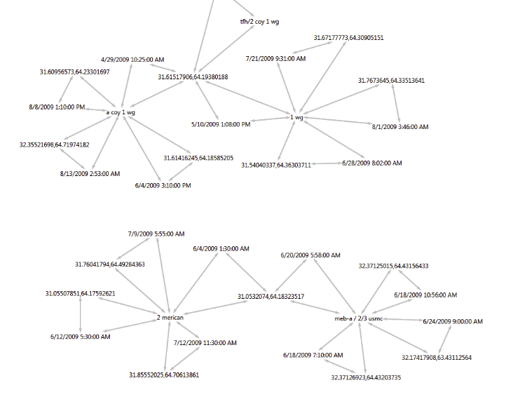
V. Data Cleaning and Entity Resolution

Slide 24
VI. Modeling Uncertainty
Veridicality is the assertion of truth of any piece of information. For DHRV, veridicality is measured as a function of phrase tree distance of location, time, and person markers and the strength of uncertainty indicators between the relevant leaves.
519 indicators of uncertainty in English collected from the literature on veridicality and from various corpora. Currently collecting survey data on degree of uncertainty indicated by phrases in various sentential and semantic contexts.
Design
Phrases = {p_{i}, p_{j}, p_{k}, … p_{n}}
Sentence Blanks = {s_{a}, s_{b}, s_{c}, … s_{n}}
Bins = {b₁, b₂, b₃, … b_{n}}
Bin₁ = {p_{i}, s_{a}, p_{j}, s_{b}, p_{k}, s_{c}, … p_{n}, s_{n}}
Example
Bin 1 = Modals
Phrase 1, 2, 3, 4 = “may”, “must”, “could”, “ought to”
Sentence 1 = “I ___ have seen the Chief on the 16th floor.”

Slide 25
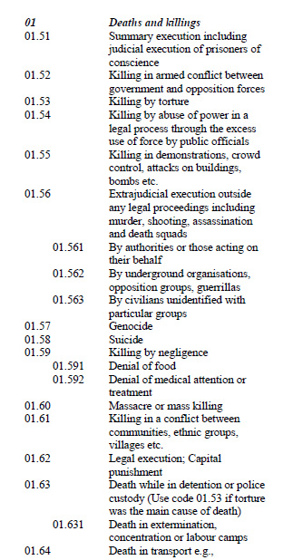
VII. Modeling Violations
HURIDOCs developed an ontology of Rights, Violations, Types, Methods, Acts, and correlated information containing ~1,200 categories in a hierarchical classification schema
Developing an LSA for rights violations, as conventional semantic spaces don’t contain domain relevant language vectors for accurate classification of detailed rights violations
N. Cross and H. Jarvis. 1999. CGDB: Input Manual for CBIB.
Cambodian Genocide Program. 52.

Slide 26
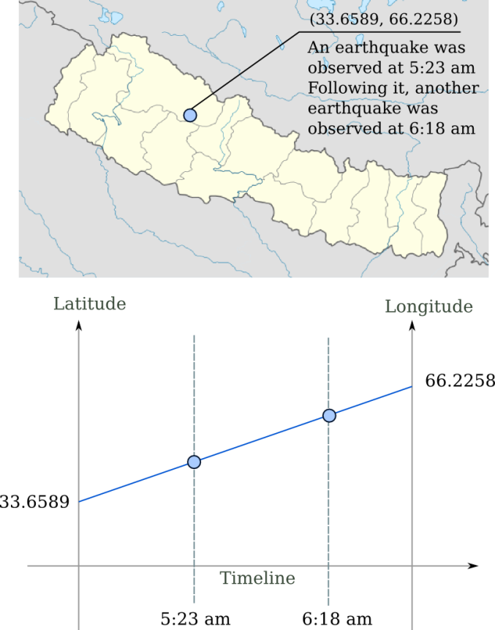

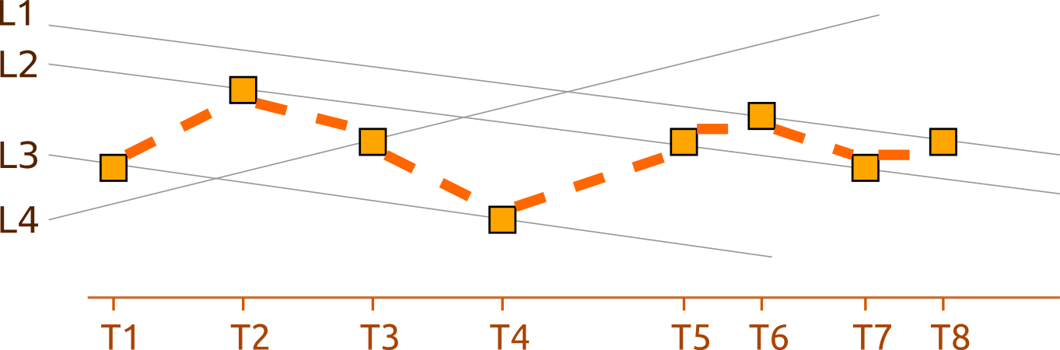
VIII. Storygraph and Storyline Visualizations
Parallel coordinate plots originated by Philbert Maurice d'Ocagnein in 1885, modernized in the 1970s by Al Isenberg.
Our implementation of a 2-axis parallel coordinate graph emphasizes events over time at locations.
Cartesian plots emphasize an easy to recognize location but occlude time.
Each point represents an entity at a location at a given time
Secondary trails can be drawn connecting the various appearances of an entity in the visualized corpus
These Storylines show the movement of individuals, or ideas, across the space and time of a documented event

Slide 27
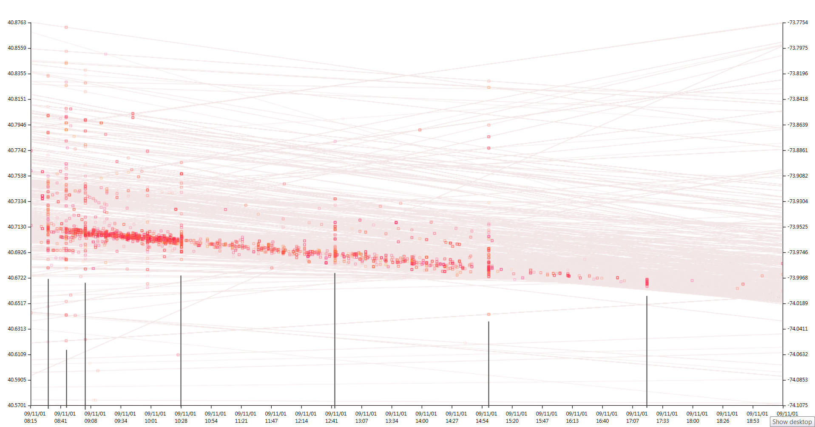
VIII. Storygraph Visualization of World Trade Center Task Force Interviews
Y2 axis = Longitude
Y1 axis = Latitude
Tangent lines = locations
~7,500 data points of 2,050 entities at 2,151 locations at various times
X axis = Date & Time

Slide 28
VIII. Storygraph Visualization of World Trade Center Task Force Interviews
2 World Trade Center Collapses
United Airlines Flight 175 hits 2 WTC
American Airlines Flight 11 hits 1 WTC
7 World Trade Center Falls

Slide 29
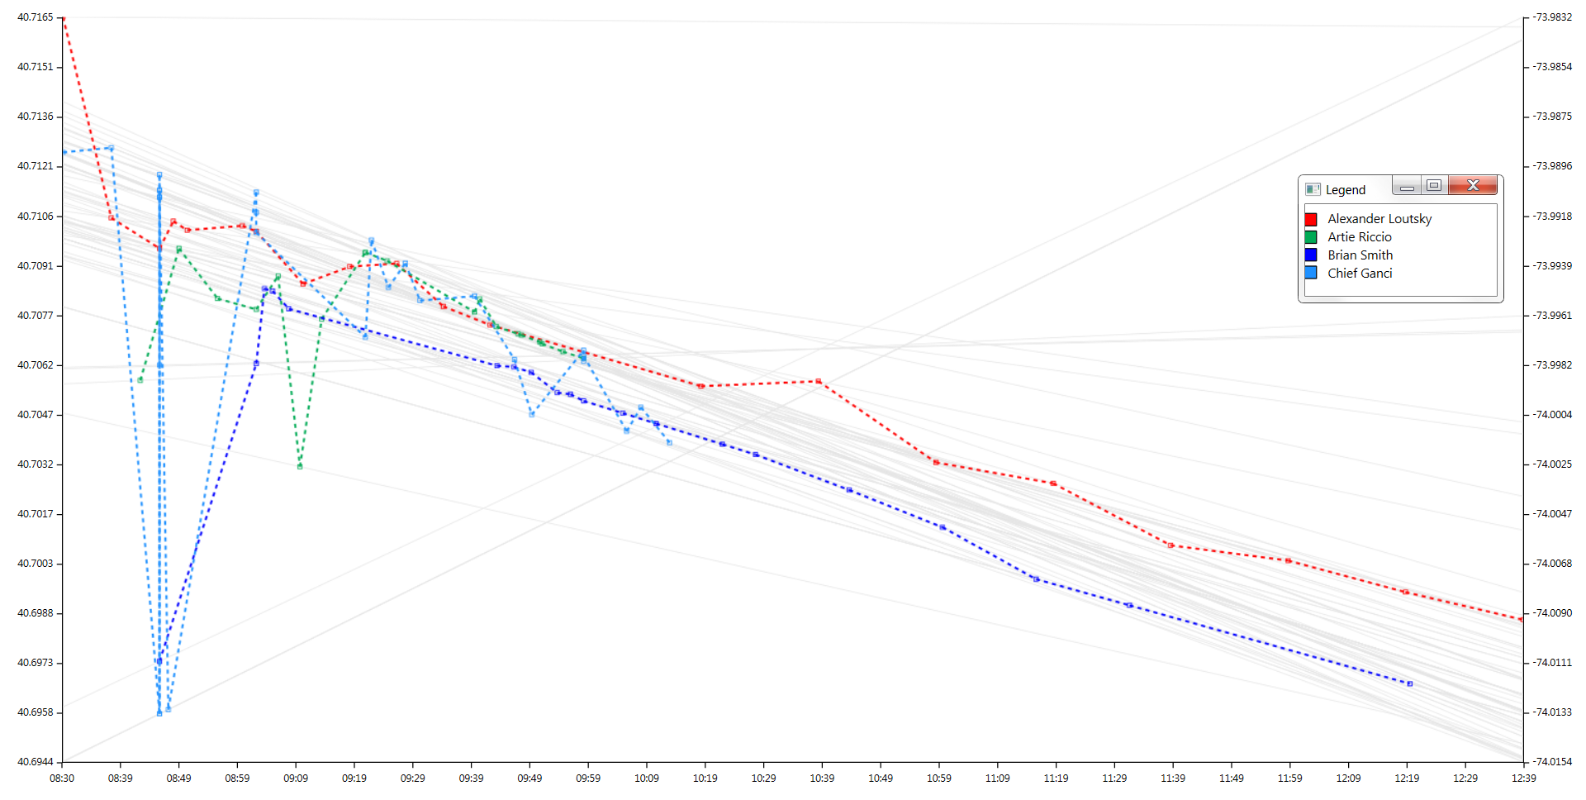
VIII. Storyline Visualization of World Trade Center Task Force Interviews
Tower 1 Falls
Parallel operations in vicinity of North and South Towers
Multiple Incompatible Sightings

Slide 30
IX. Next Steps
More data for modeling
Multilingual pipeline (currently testing Spanish pipeline)
Develop rights-sensitive LSA
Connect with other Human Rights NGOs, GOs, and research groups
Integrating uncertainty values to veridicality measure
Real-time edge bundling on Storygraph
Duration of event on Storygraph
Parallel Storylines, allowing for visualization of group movements over time
Automatic collapsing of Storygram network graph triples
Fuzzy matching for data cleaning and extrapolation
A synthetic analytic ecosystem guiding work from corpus to document to coding to cleaning to visualization
Follow-on funding
Apply our methods to other contexts

Slide 31
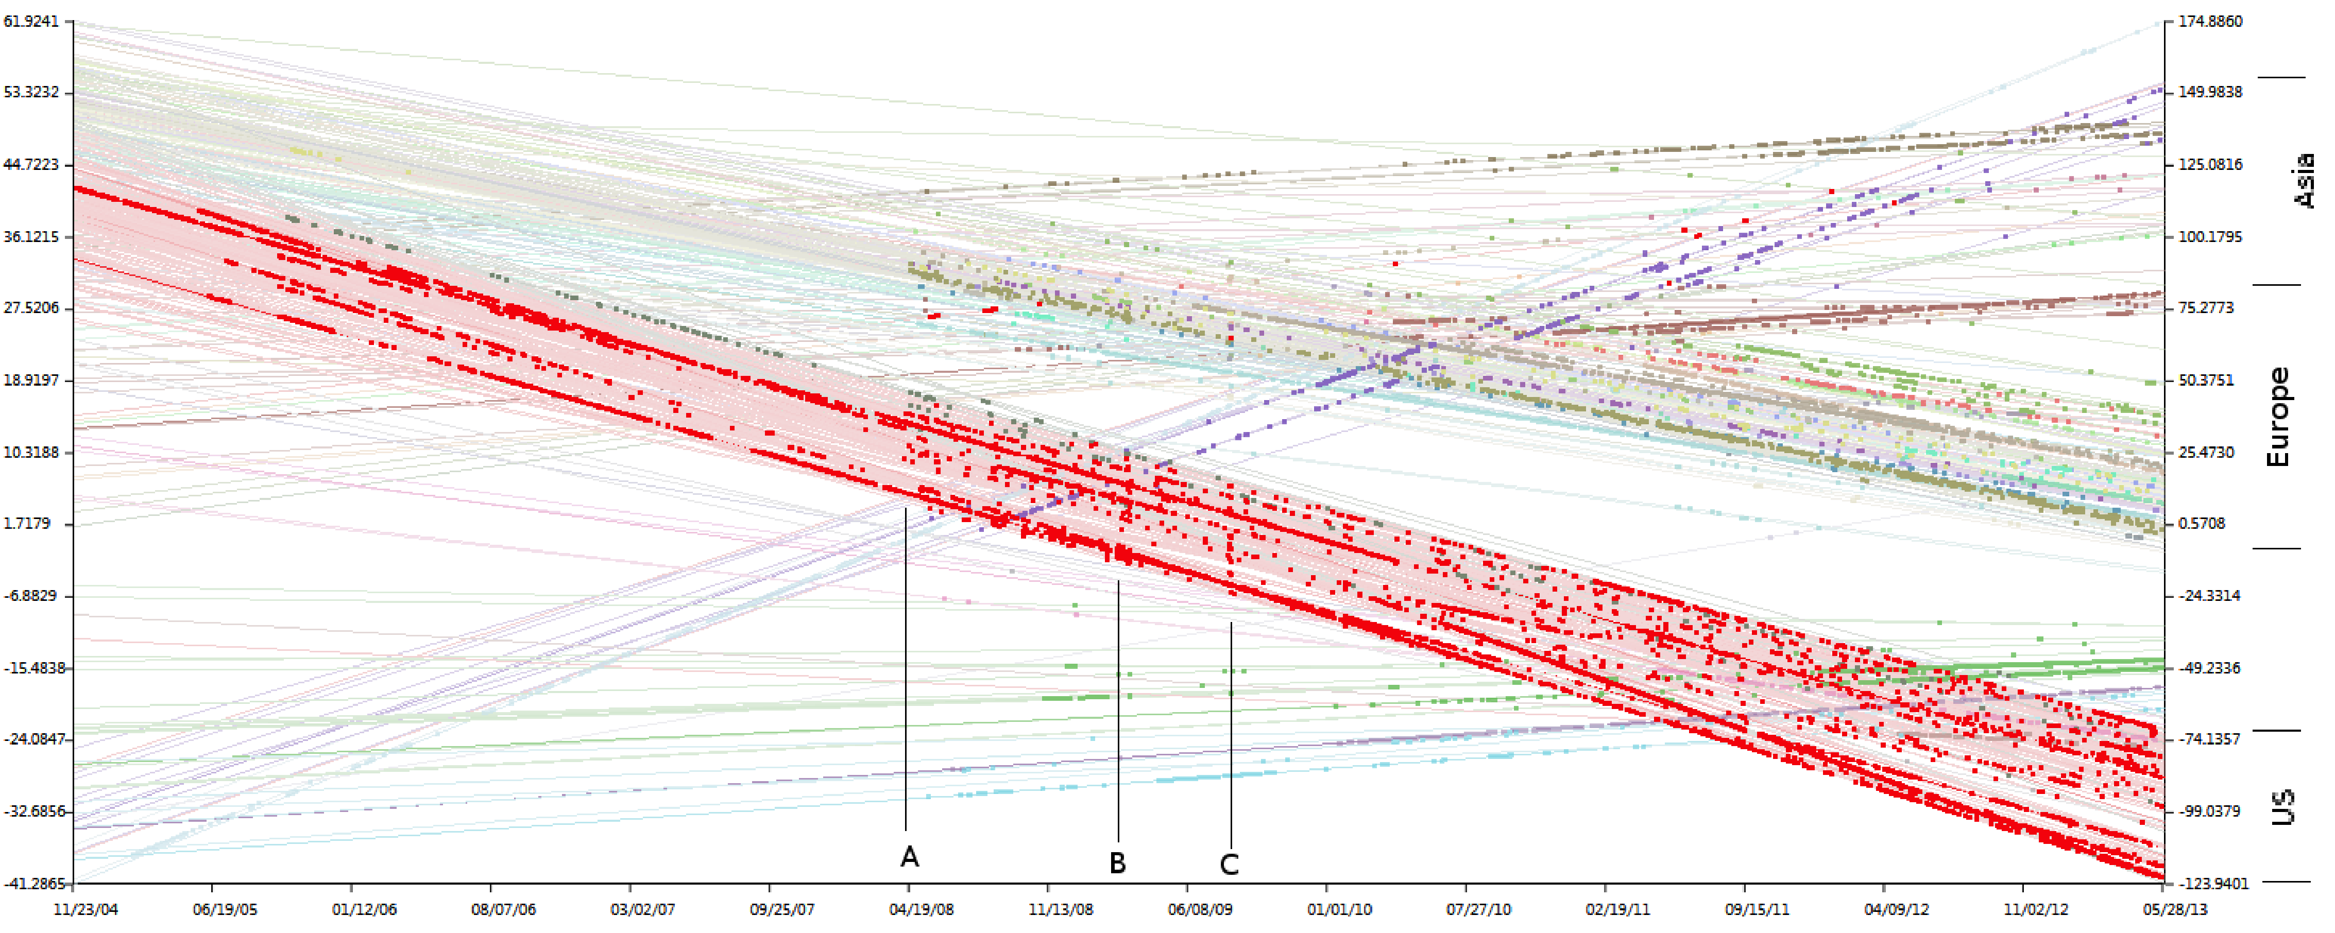
X. Other Contexts: Rails commits on GITHUB
Shrestha, Zhu, Miller. Visualizing Time and Geography of Open Source Software with Storygraph. IEEE VisSoft 2013.
Vertical banding at A, B, and C, indicate closely-timed commits at many locations
p = 0.8 so as to subdue low-commit locations
approx. 44k commits
Over 10 case studies, found that high-commit projects have developer locations active throughout lifecycle
next steps include identifying nature of commit (file, doc, library, etc) and using Storygraph to investigate how and when coding gets outsourced

Slide 32


XI. Thanks and contact info
The doctoral fellows of GSU’s Second Century Initiative in New and Emerging Media and the graduate students of Western University
The human rights NGOs facilitating the project’s negotiations with data vendors and the researchers who participated in our studies
Interview and questionnaire participants; Stories Matter representatives
Our funders (NSF Award 1209172, SSHRC Program 869):
For more information
Ben Miller Lu Xiao
miller@gsu.edu lxiao24@uwo.ca
@intransitive
http://digging.gsu.edu http://hci.fims.uwo.ca
For Storygraph & Storylines
https://github.com/sayush/E2

