Slide 1
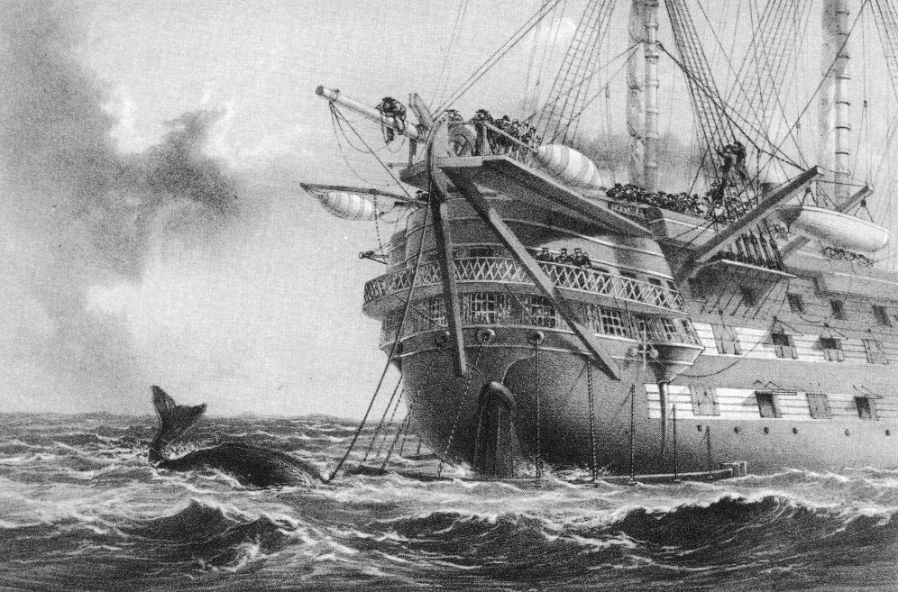
Oceanic Exchanges: Tracing Global Information Networks In Historical Newspaper Repositories, 1840-1914
oceanicexchanges.org | @OceanicEx

Slide 2
Deutschland - Deutsche Forschungsgemeinschaft (DFG)
Marc Priewe (PI), Clemens Neudecker, Sebastian Padó, Steffen, Martin Riedl, Jana Keck, Steffen Koch
México - Consejo Nacional de Ciencia y Tecnología (CONACYT)
Isabel Galina (Co-PI), Ernesto Priani (Co-PI), Miriam Peña, Iván Meza, Adan Lerma, Rocío Castellanos, Laura Martínez, Ximena Gutiérrez Vásques, Gilberto Leon Martagón, Marco Godinez, Fabiola Delfín, Laura Angélica López
Nederland - Nederlandse Organisatie voor Wetenschappelijk Onderzoek (NWO)
Jaap Verheul (PI), Lorella Viola, Hanneke Takken
Suomi - Suomen Akatemia (AKA)
Hannu Salmi (PI), Asko Nivala, Mila Oiva, Otto Latva
United Kingdom - Arts & Humanities Research Council and Economic and Social Research Council (AHRC/ESRC)
Melodee Beals (Co-PI), Julianne Nyhan (Co-PI), Melissa Terras, James Hetherington, Raquel Alegre, Emily Bell, Tessa Hauswedell, Roma Klapaukh, Olivia Mitchell
United States of America - Institute of Museum and Library Services (IMLS)
Ryan Cordell (Co-PI), David Smith (Co-PI), Paul Fyfe, Elizabeth Lorang, Leen-Kiat Soh, Lara Rose, Chulwoo (Mike) Pack, Ye Liu, Jamie Parker

Slide 3
Newspaper Databases
British Library 19th Century Newspapers
Chronicling America
Delpher
Europeana Newspapers
Hemeroteca Nacional Digital de México
Papers Past
Suomen Kansalliskirjaston digitoidut sanomalehdet
Times Digital Archive
Trove
ZEFYS
Data Stats
70,490,294 “documents” 3,428,612 distinct newspaper issues
Work Packages
WP1: Project Management & Communication WP2: Data Gathering
WP3: Data Ontologies
WP4: 19th-Century Newspaper Reprinting
WP5: 19th-Century “Concept Drift”

Slide 4
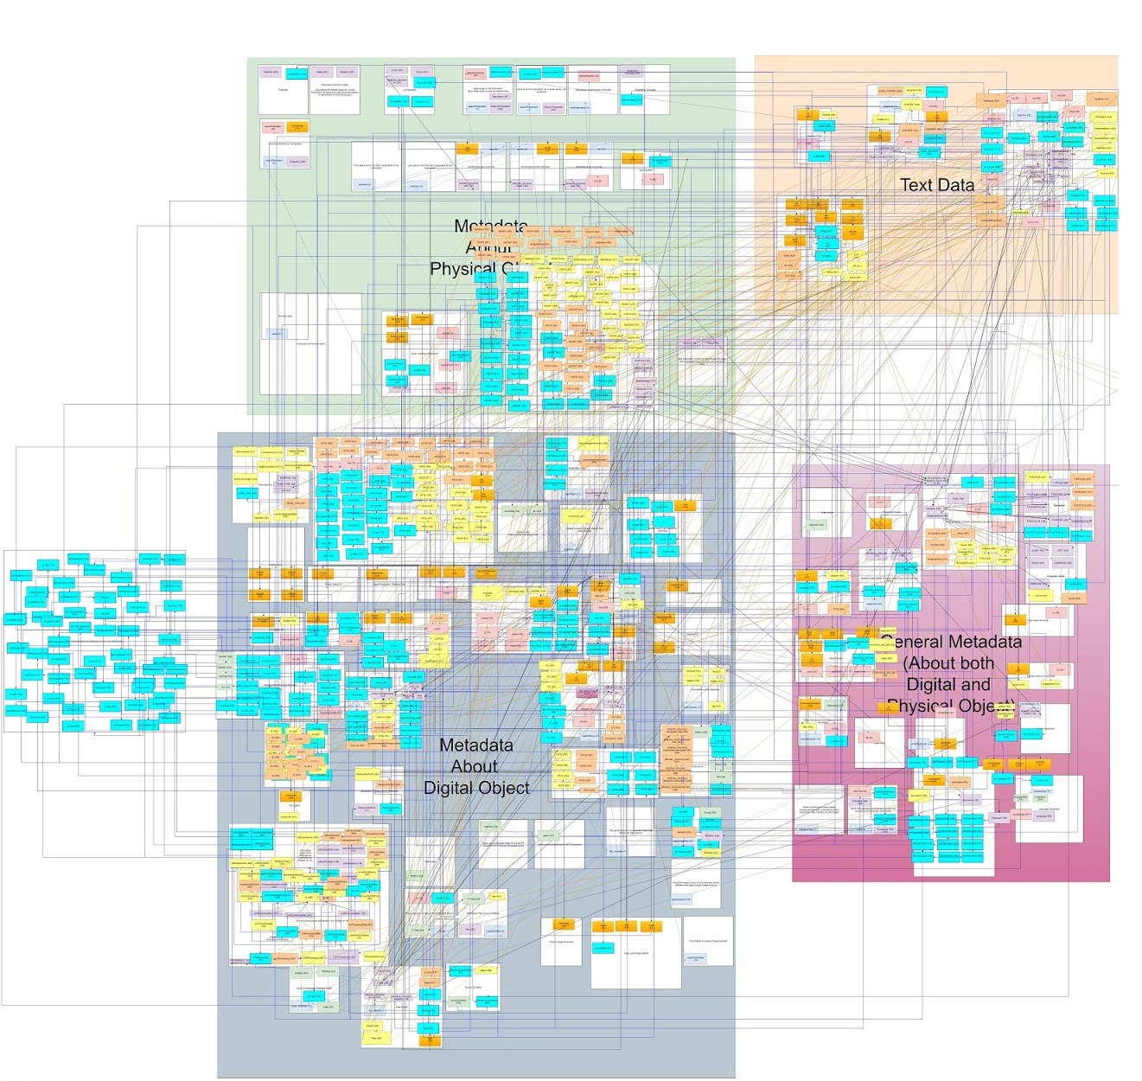
WP3: Ontologies

Slide 5
WP3: Ontologies
Open Access Dataset
Available at https://github.com/OceanicExchanges
Contains the metadata structure of all digitised collections from the project.
Includes field definitions, element/attribute hierarchy and example content.

Slide 6
WP3: Ontologies
The Atlas of Digitised Newspapers and Metadata
https://www.digitisednewspapers.net/
An open access guide to digitised newspapers around the world, bringing together their histories and digitisation choices with a deeper look at the language of the digitised newspaper, the evolution of newspaper terminology and the variety of metadata available in these collections.
Explores how machine-readable information about an issue, volume, page, and author is stored in the digital file alongside the raw content or text, and provides a controlled vocabulary designed to be used across disciplines, within academia and beyond.
Draws on our open access dataset, academic and industry discussion of the newspaper, digitisation guidelines, websites, annual reports, interviews and the data files.
Made available online to encourage others to add to the Atlas.

Slide 7
WP3: Ontologies
Articles
‘Of Global Reach Yet of Situated Contexts: An Examination of the Implicit and Explicit Selection Criteria that Shape Digital Archives of Historical Newspapers.’ Tessa Hauswedell, Julianne Nyhan, M. H. Beals, Melissa Terras and Emily Bell. Archival Science: International Journal on Recorded Information, [forthcoming].
“El uso de periódicos digitalizados como fuente para trabajos de investigación (The use of digitized newspapers collections for research)” Castellanos Rueda Rocío, Galina Russell Isabel, Martínez Domínguez Laura, Peña Pimentel Miriam, Priani Saisó Ernesto. [submitted for peer review].
In progress:
A linked open dataset, to be made available on the semantic web, that creates a newspaper ontology based on the history of the newspaper and the digital structure of newspaper databases.
School resources, including lesson plans, encouraging a more ethical and historically-informed use of newspapers.
Workshops to be held in North America, Europe and Australia which will introduce participants to the Atlas.

Slide 8
WP4: Case Studies
The Eruption of Krakatoa/au (1883)
Lajos Kossuth’s Exile in the United States (1851/1852)
Transatlantic Cable (1858)
Spanish American War: The Explosion of the USS Maine (1898)
The French Invasion of Mexico (1862)
A Finnish Murder Case: The Murder of General Governor Bobrikov (1904)

Slide 9
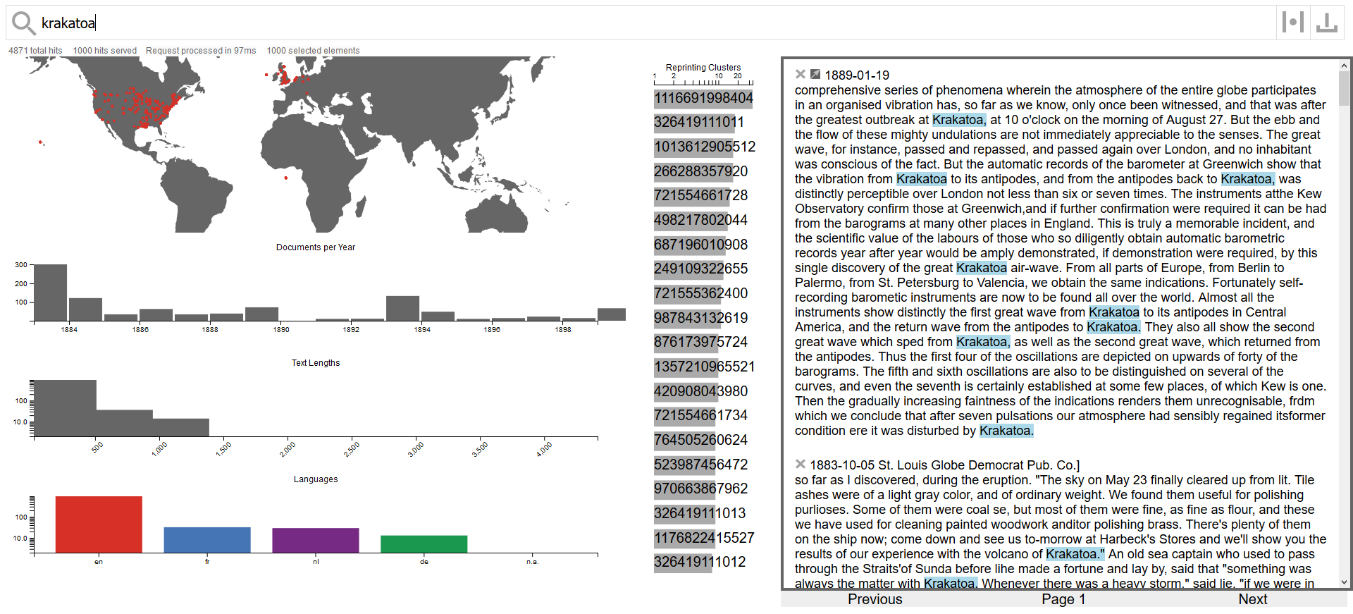
WP4: Visualizing Newspaper Data

Slide 10
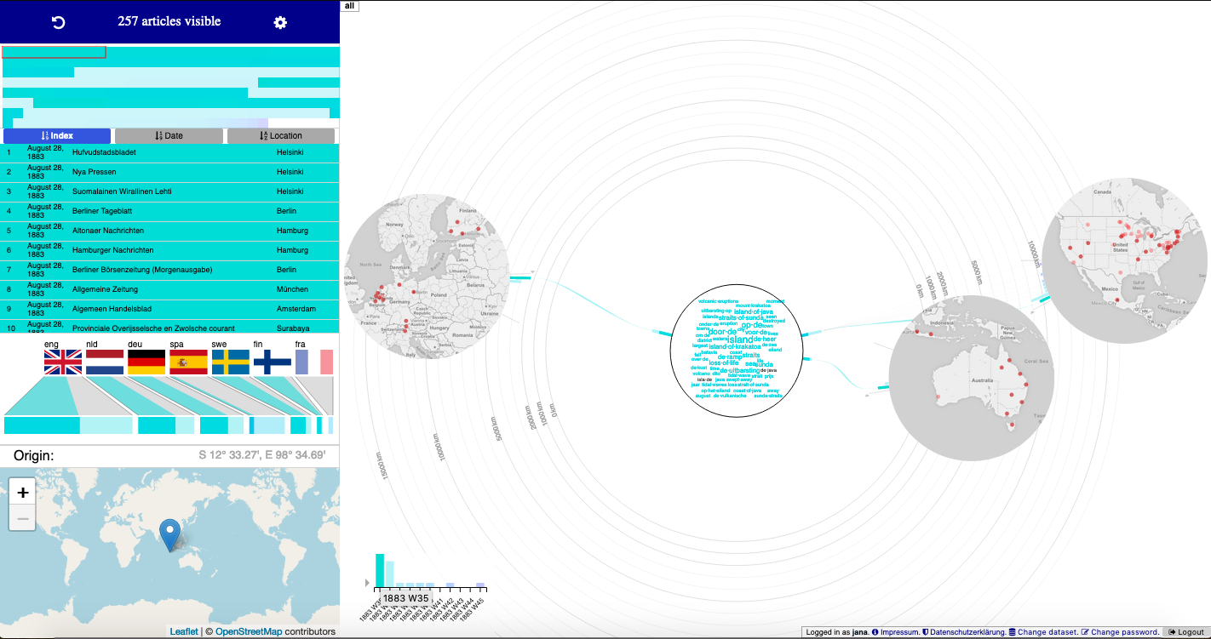
WP4: Visualizing Newspaper Data

Slide 11
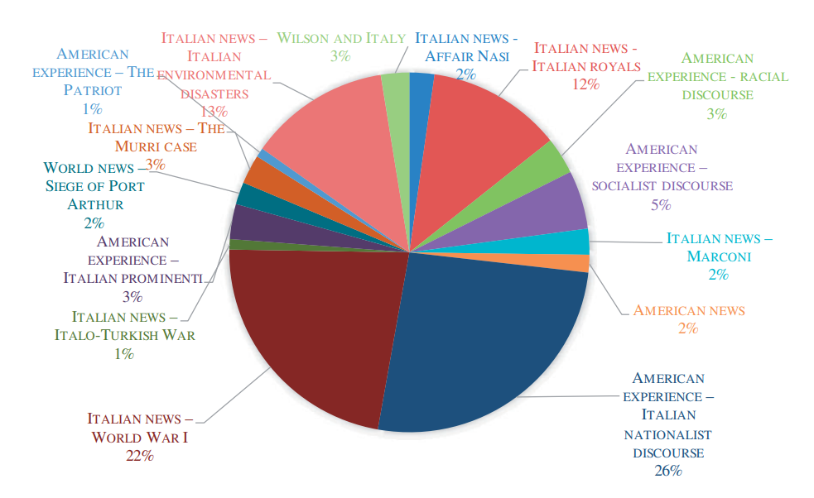
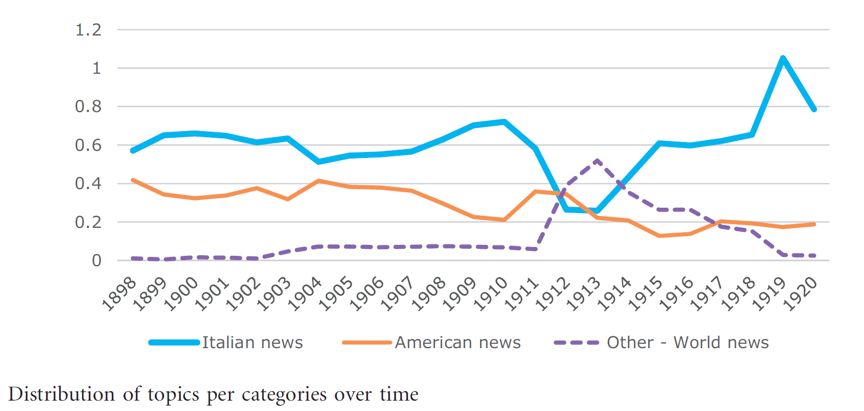
WP 5 Conceptual Migration and Translation
Goal: analyze migration of ideas and concepts across the Atlantic
Project 1: Diasporic media as nodes in transatlantic transfer of knowledge
Construction of transatlantic identities as a result of migration
References to homeland and host society in immigrant newspapers in the US
Methods: topic modelling and discourse analysis
.

Slide 12
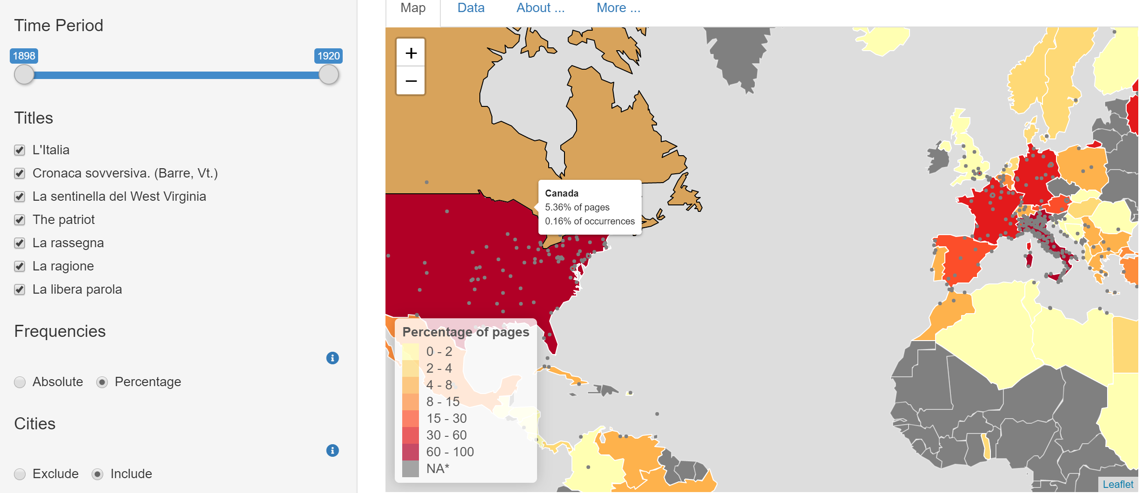
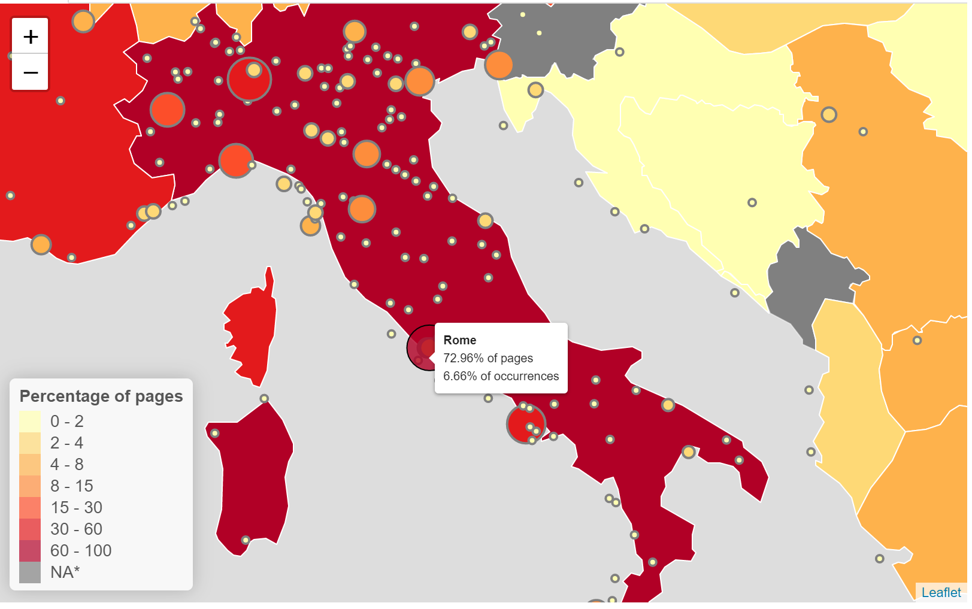
WP 5 Conceptual Migration and Translation
Times Digital Archive
Project 1: Diasporic media as nodes in transatlantic transfer of knowledge
References to toponyms (countries, regions, cities) in Italian American newspapers,
Employ machine learning for conceptual NER extraction
Interactive visualization: (time period, periodicals, country/region/city, historical borders)
GeoNewsMiner

Slide 13
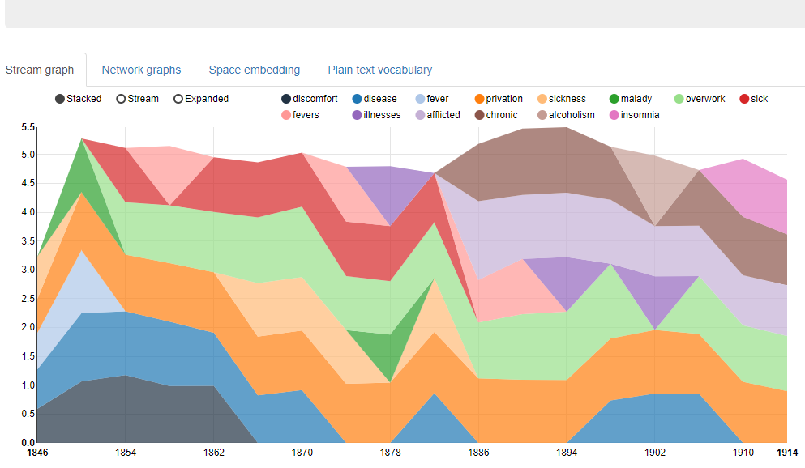
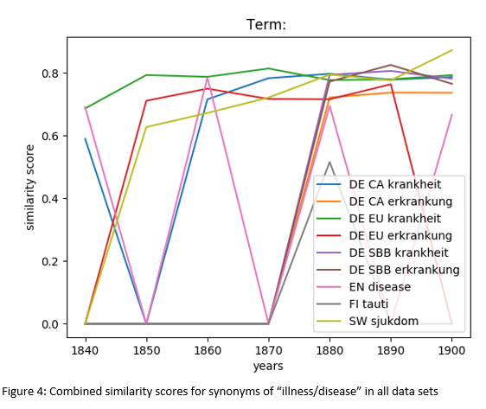
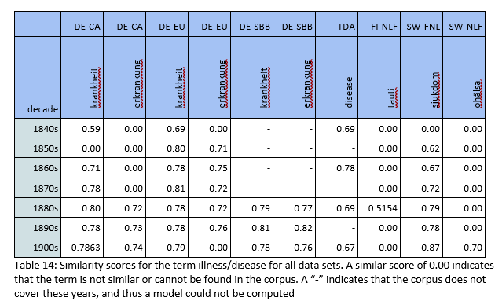
WP 5 Conceptual Migration and Translation
Times Digital Archive
Project 2: Using word vector models to trace how concepts are expressed in changing vocabularies
Comparing German, Swedish, UK and US newspapers, 1840-1914
Two concepts
Illness (private, individual)
Nation (public, collective)

Slide 14
Oceanic Exchanges: Tracing Global Information Networks In Historical Newspaper Repositories, 1840-1914
oceanicexchanges.org | @OceanicEx

