Slide 1
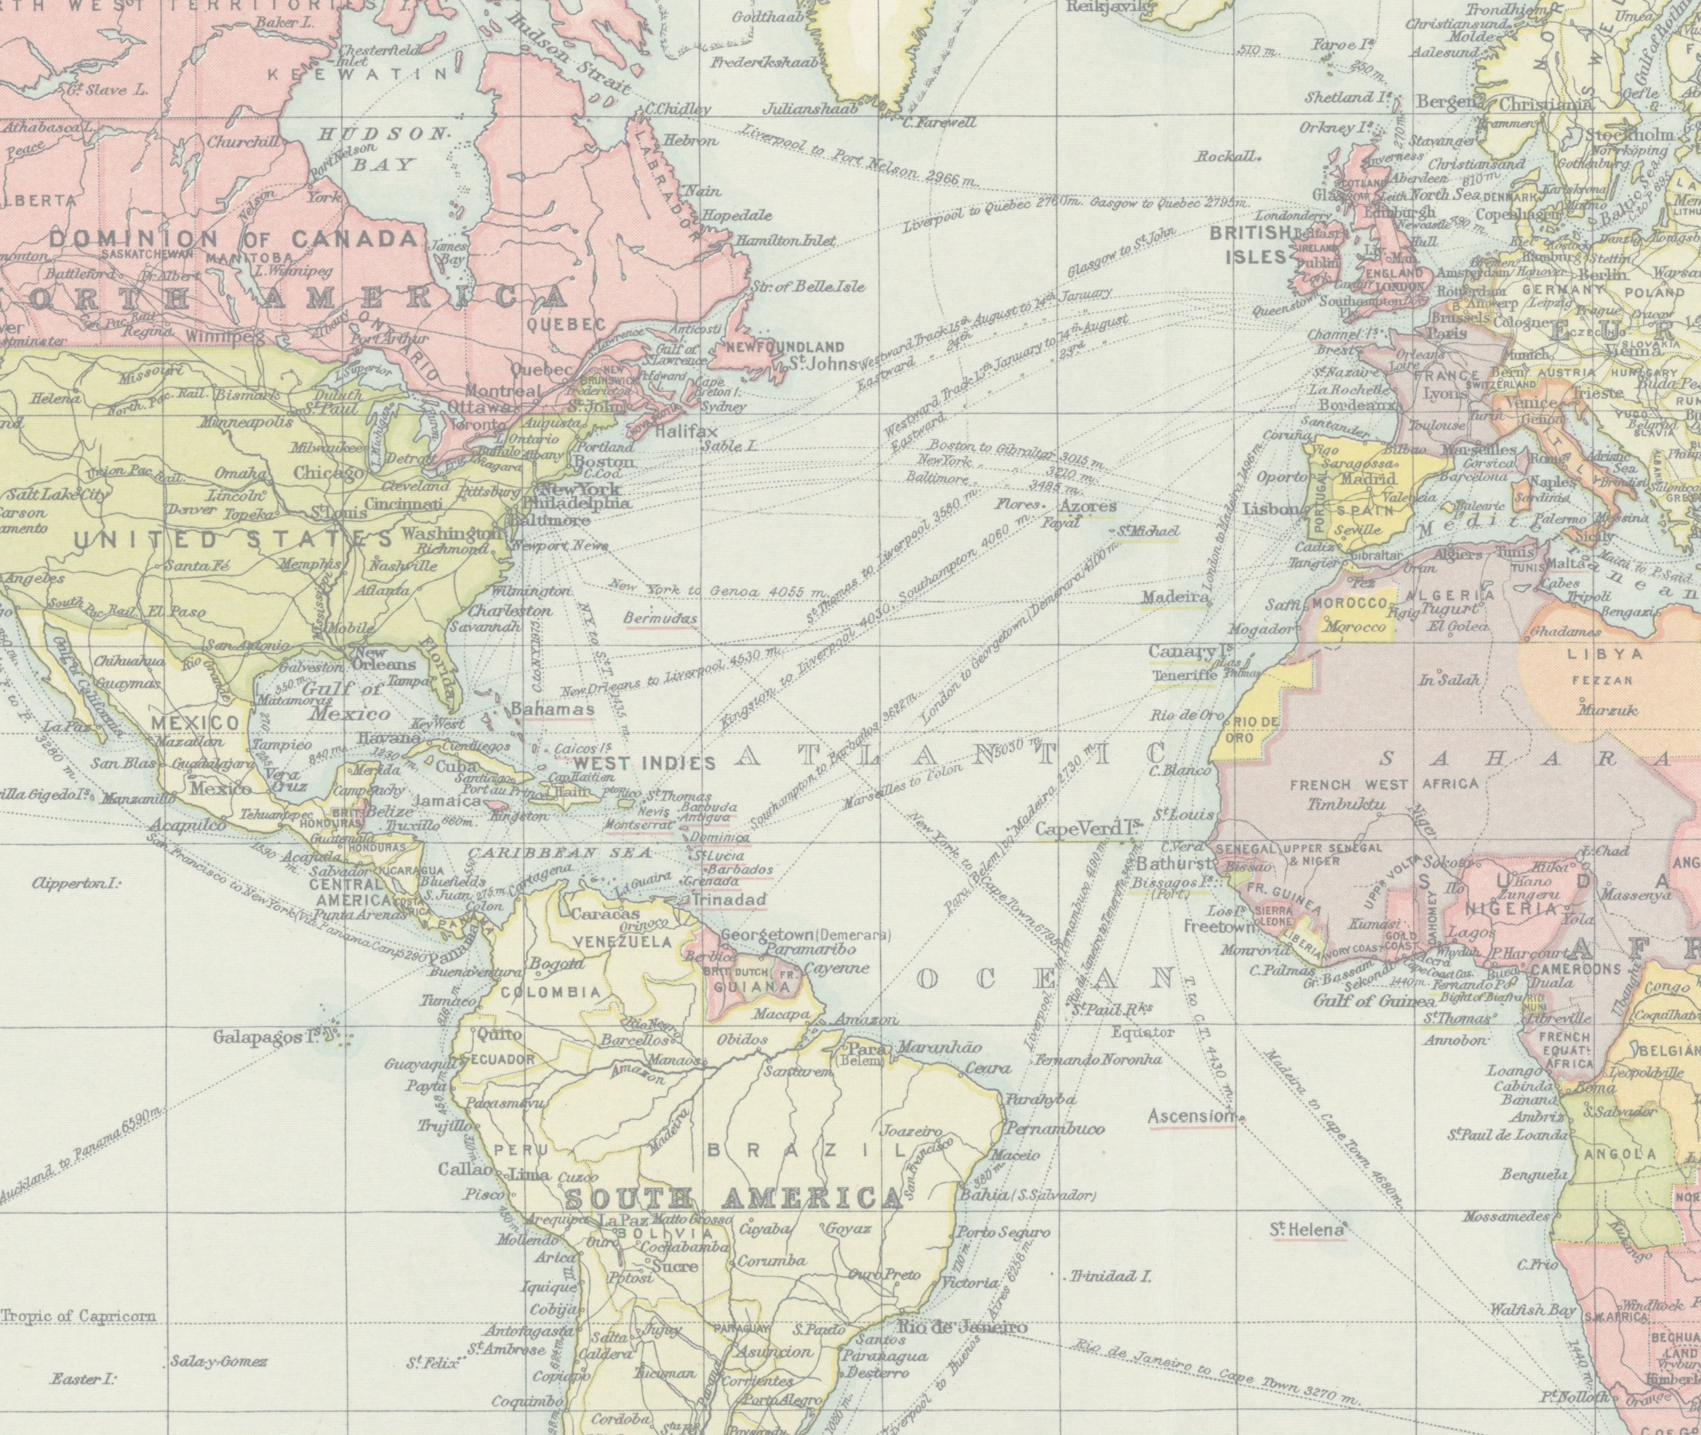
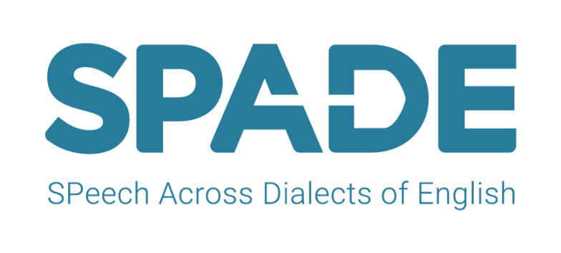


August 2017 – July 2020
http://spade.glasgow.ac.uk/
Notes:
Title slide
1

Slide 2
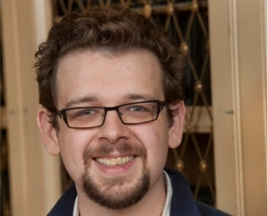
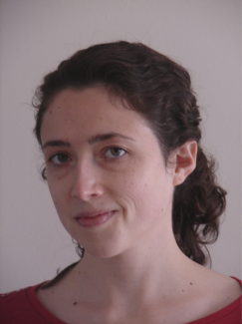

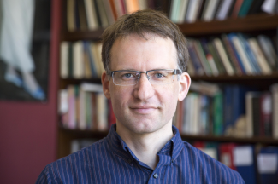
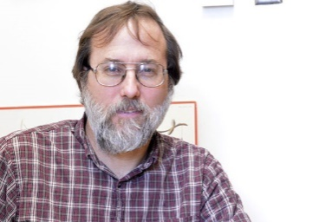


Investigators
http://spade.glasgow.ac.uk/
Notes:
Here are the Investigators - full details at our website
2

Slide 3
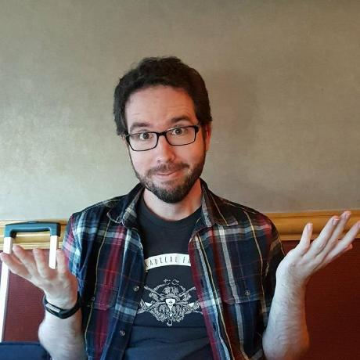
Postdocs
http://spade.glasgow.ac.uk/
Graduates + undergrads: many
Project manager + data
Software development
Notes:
Here are the Investigators - full details at our website
3

Slide 4
Developers
Docs, QA
Arlie Coles (U. de Montréal)
Elias Stengel-Eskin (Johns Hopkins)
Michael Goodale, Sarah Mihuc (McGill)
Michael McAuliffe
James Tanner, Vanna Willerton (McGIll)

Slide 5
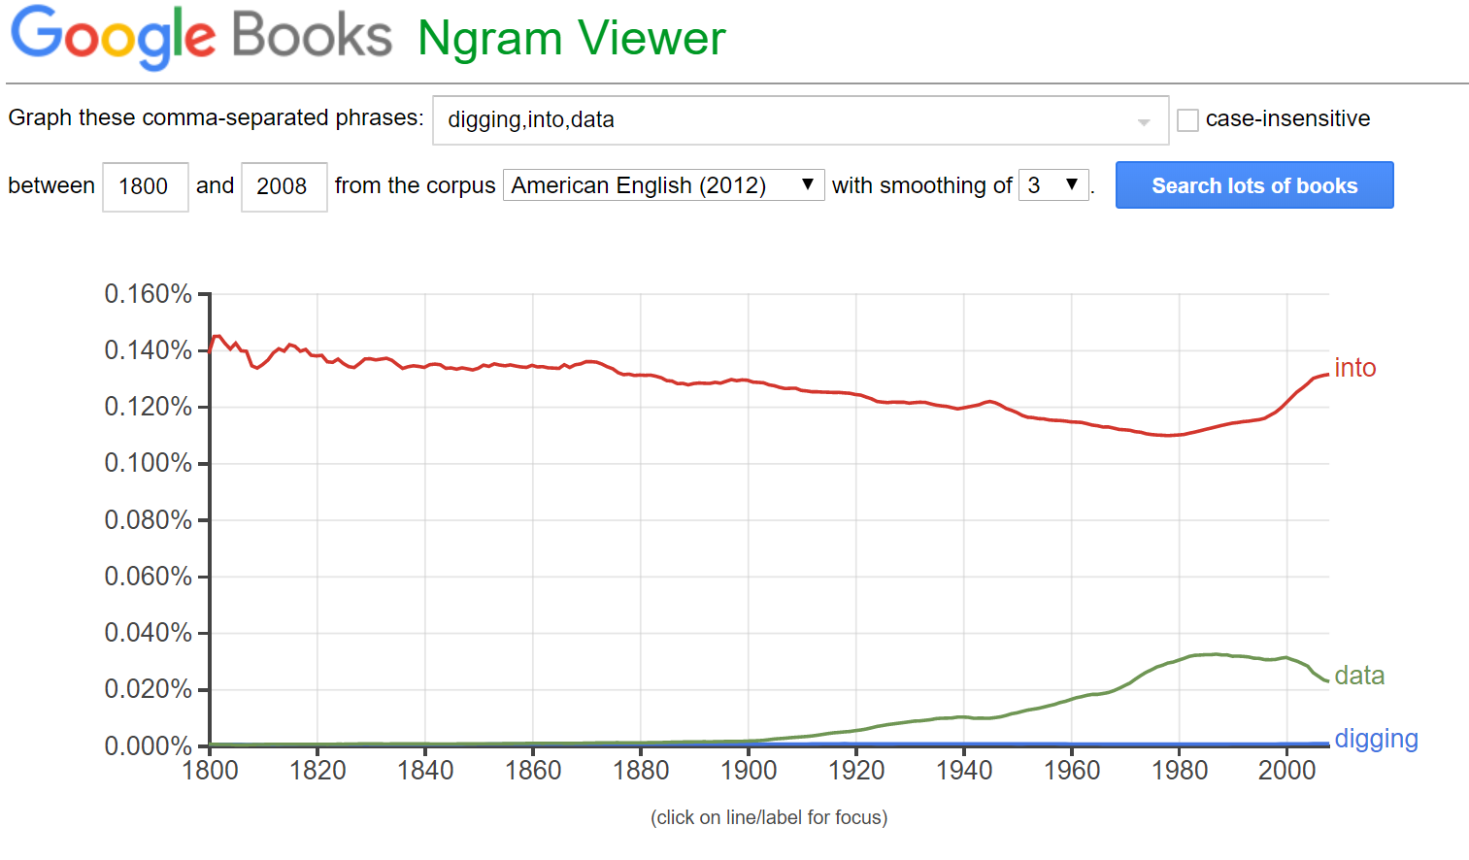
Text over time and space
into
data
digging
Notes:
Start with slide showing text search across time + space, like google n-gram viewer for AmE from1800-2008 for digging, into, data. This is from *books* -- (copyright-)restricted data – but can easily do this kind of search, ask scientific or cultural Qs.
(Motivation: last slide of this presentation will be going to the Shiny app – a time/space visualization just like ngram viewer – and saying “come to our demo”)
5

Slide 6
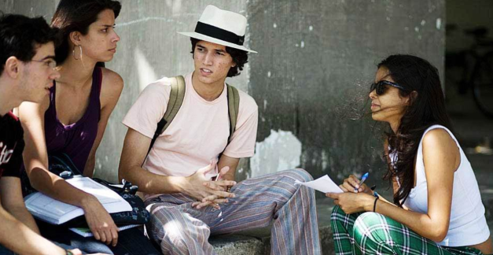


Huge amounts of annotated speech exist…
Scientific and/or professional user questions, e.g.
barriers
How variable are ‘English’ sounds across space/time?
Does speaker voice quality indicate stress?
$$ ££
Software
Ethics
Goal: overcome barriers and scale up scientific study of speech
Notes:
The idea is to convey data exists, answering Qs possible – but there are barriers, which don’t really exist for tech. our big project goal is to overcome these.
(NB: for “child speech”, they’ll just have seen ACLEW presentation)
---
How does speech rate differ across languages and people?
What is the “English” vowel space, across all dialects? Is it changing, with increased globalization?
Are there cross-linguistic universals in how people speak to cats? ☺
Barriers to using and sharing speech corpora. $3000 is just for Switchboard 1. (Switchboard 2 is much more.) Ethics protocols, data sharing, etc. are getting better for socio, lab data. But we will always not be able to fully share data, for ethical reasons. And most of the questions we want to ask *don’t require access to ethically-sensitive info* (vowel formants and word frequencies, not someone’s exact words or identifiable voice).
6

Slide 7

Project goals
Software large-scale speech analysis
Data from ~40 datasets
(socio)linguistic
surveys
Research ’English’ sounds over time and space
Notes:
-> software, data, case studies. More details come in later slides
Long-term goal: to enable the automatic search and extraction … of the same information about speech… from multiple, diverse, speech corpora … public and private … by less and more experienced users
7

Slide 8
Integrated Speech Corpus ANalysis (ISCAN)
McAuliffe et al. Proc. ICPhS 2019
import
querying
export
Datasets (speech corpora, lexicons)
Database
Set of linguistic objects
Data file (CSV)
add measures & structure
Implementation
  Python API
  Graphical User Interface
Michael McAuliffe
Notes:
Any procedure a researcher uses to go from raw data to a usable CSV file has four parts. In your workflow the parts may not be in this order – may have a single script that just does them all – but workflow can be conceptually broken down this way. Let’s first think about the first two: going from raw data, in whatever messy format, to a set of variables and measures suitable for linguistic analysis.
Removed slide with software goals: Scalable & fast
Require minimal technical skill from user
Abstraction away from dataset format
Querying dataset without access to raw data
⇒ Easier large-scale studies using speech corpora
8

Slide 9
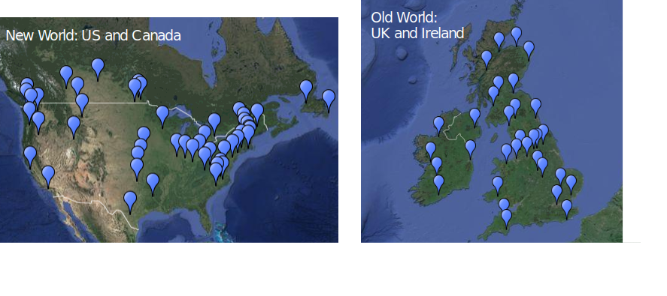
https://spade.glasgow.ac.uk/the-spade-consortium/
Datasets
UK and Ireland
US and Canada
40 collected: public/private, 4 countries, 115 years
25 processed: 30 dialects, ~4500 speakers, ~2060 hours
18 measured
Notes:
9

Slide 10
Research: 7 Case Studies
Sibilants
Vowels: formants
Stuart-Smith et al. Proc. ICPhS 2019
Mielke et al. Proc. ICPhS 2019
Vowels: voicing effect
Tanner et al. Toronto WP Ling 2019
Vowels: Scottish patterns
Vowels: dynamic
r and l
Stops
https://spade.glasgow.ac.uk/news-outputs/
Notes:
10

Slide 11
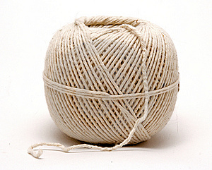
Notes:
What’s this for you? string or shtring? S-retraction
11

Slide 12
How does S-retraction vary across dialects and speakers?
Stuart-Smith et al. Proc. ICPhS 2019
Updated analysis
https://osf.io/bknrg/
Notes:
/s/-retraction across English dialects: there are ‘retracting’/non-retracting dialects and speakers.
Rests on another received wisdom: English sibilants don’t differ much by English dialect.
Important to note that findings to date are all based on individual studies, different methodogies, relatively small # speakers. We are not actually sure what is “known” – even, is /s/-retraction a discrete thing at all, that can happen or not happen for English speakers? A cross-dialect study across many speakers, using same methods, lets us check. (Note: by-speaker = within dialect) (e.g. Baker et al, 2011; Stevens and Harrington, 2016)
12

Slide 13
S-retraction differs by dialect
US
Scotland
Canada
more like ‘s’
more like ‘sh’
420 speakers
~ 77k tokens
Notes:
Measure of degree of /s/ retraction: (/str/ mean - /sh/ mean). 0: “st(r)ew” = “shrew” 1: “st(r)ew” = “stew”
Say what we see on the plot. Dialects differ. And we can be pretty confident that all show *some* amount of retraction – as expected, by coarticulation. A couple dialects known to be ”retracting” from prev work are most retracted, which is good. But NCS is supposed to as well (though low N). However, no clear dichotomy between “retracting” and “non-retracting” dialects.
13

Slide 14
S-retraction differs by dialect
US
Scotland
Canada
more like ‘s’
more like ‘sh’
420 speakers
~ 77k tokens
… on a continuum (no dichotomy)
Notes:
A couple dialects known to be ”retracting” from prev work are most retracted, which is good. But NCS is supposed to as well (though low N). However, no clear dichotomy between “retracting” and “non-retracting” dialects.
14

Slide 15
S-retraction differs more by speaker
Density (speakers)
US
Canada
Scotland
420 speakers
~ 77k tokens
Retraction ratio for /str/, e.g. string
Notes:
speakers differ. A lot.
In some dialects, non-retractors are basically absent. Important caveats here is that we probably don’t have enough data to estimate individual speakers well. So if there is a dichotomy, wouldn’t detect it.
15

Slide 16
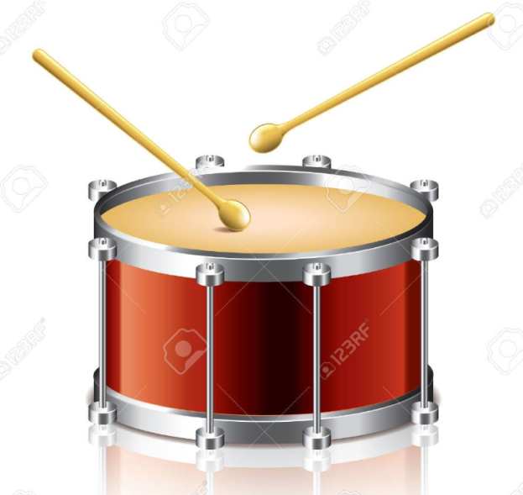
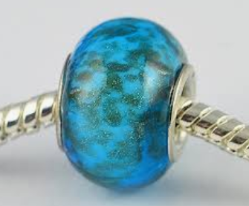
Tanner et al. Toronto WP Ling 2019
under review, Frontiers in Computational Sociolinguistics
Notes:
Vowel duration patterns – in English in general – the Voicing Effect (beat, short, bead long, also bee/bees) but in Scottish English, bead is short).
Received wisdom: Voicing Effect is found across languages, but especially in English
How robust is it, across across dialects, speakers, in spontaneous speech?
16

Slide 17
How robust is the ‘English’ Voicing Effect?
Tanner et al. Toronto WP Ling 2019
under review, Frontiers in Computational Sociolinguistics
Notes:
Vowel duration patterns – in English in general – the Voicing Effect (beat, short, bead long, also bee/bees) but in Scottish English, bead is short).
Received wisdom: Voicing Effect is found across languages, but especially in English
How robust is it, across across dialects, speakers, in spontaneous speech?
17

Slide 18
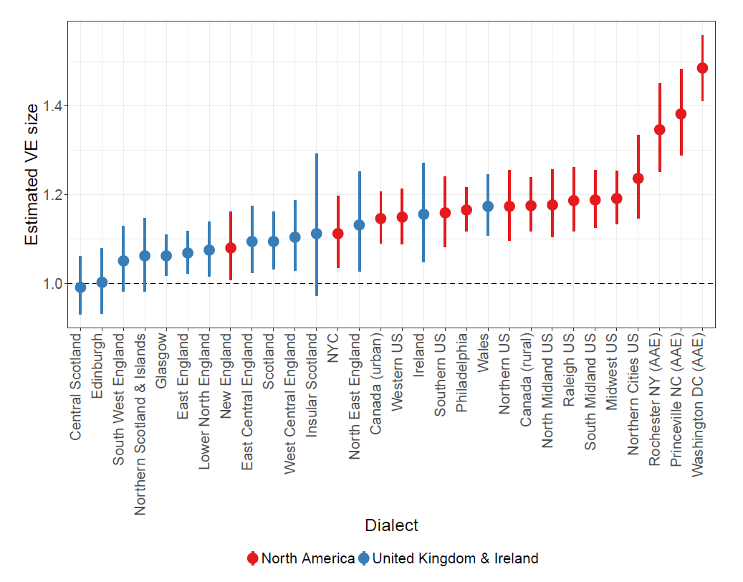
Voicing Effect differs by English dialect
Estimated Voicing Effect Size
bead > beat
bead = beat
North America
UK & Ireland
Dialect
1964 speakers
~230k tokens
Notes:
Several interesting things here. First, dialects differ substantially. Second, in dialects that do have a reliable “voicing effect”, its effect size is lower than what we’d expect from laboratory studies for this “primary” cue – usally more like 30% difference, not 5-15% (as here).
18

Slide 19
Voicing Effect differs by dialect
African American Vernacular English (big Voicing Effect expected)
Estimated Voicing Effect Size
bead > beat
Scottish (no Voicing Effect expected)
bead = beat
North America
UK & Ireland
Dialect
1964 speakers
~230k tokens
Notes:
Third, all dialects that largely show this effect are in New World – so tentatively, there is a regional feature, maybe it’s been detected and well-studied because it robustly occurs in General American. Interestingly, AAVE shows a much larger effect – as we’d expect from previous work, but not on this particular location (or time) for AAVE.
And – fourthly - Scottish dialects all show plausibly null or very small effects. Consistent with the existence of an additional duration effect on voicing (The Scottish Vowel Length Rule) that plays a more important role across Scottish dialects.
19

Slide 20
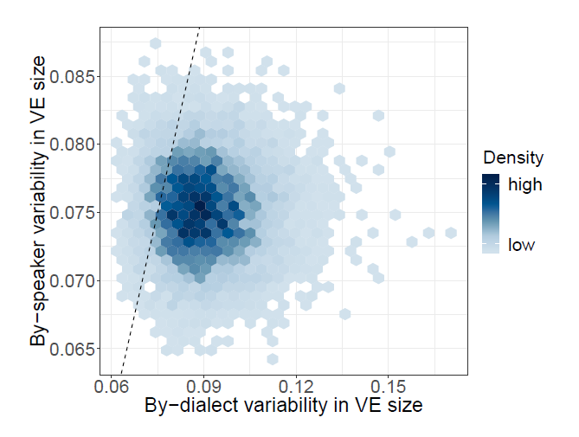
Voicing Effect differs more by dialect than by speakers
Amount of speaker variability
Amount of dialect variability
Notes:
Heatmap of posterior samples of by-dialect (^dialect) and by-speaker (^speaker) voicing effect
standard deviations. Equal variability indicated by the dashed line, with darker shades indicating
a greater density of samples.
20

Slide 21

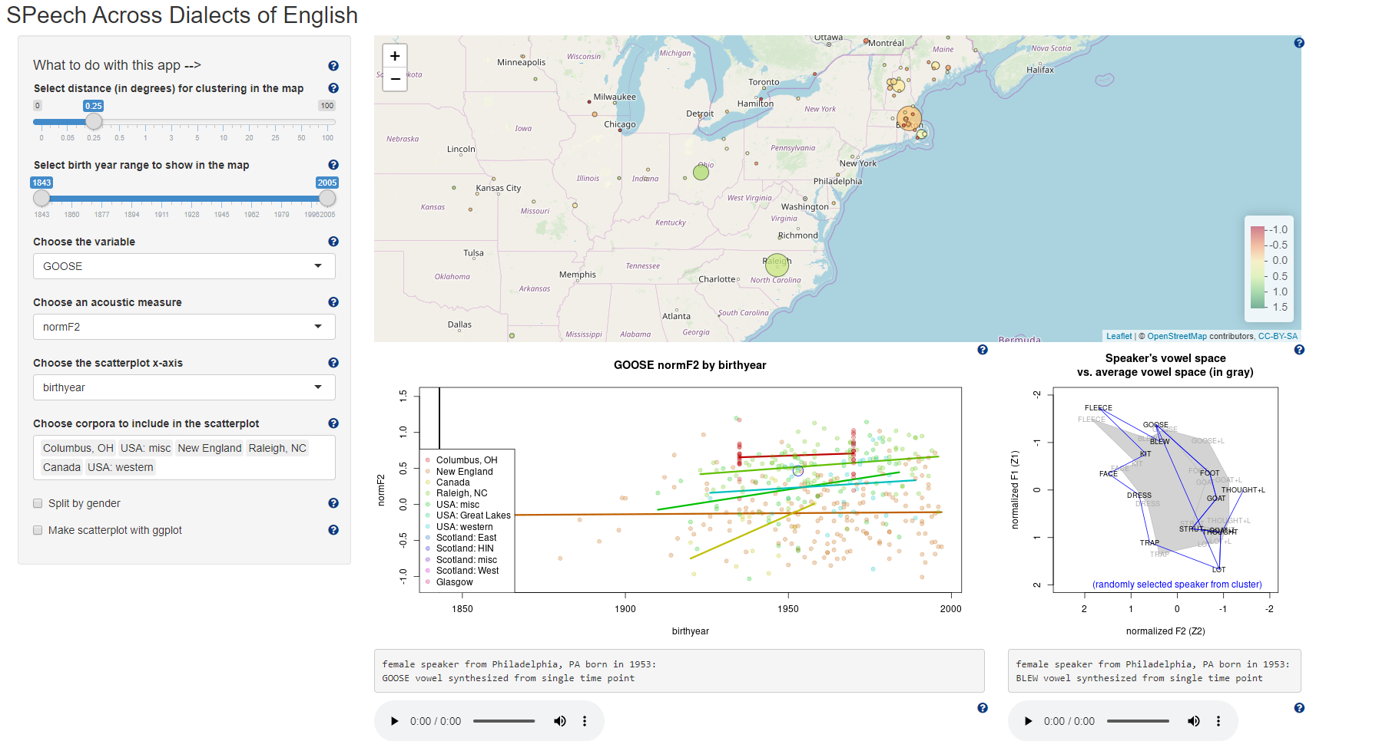
Speech over time and space
Notes:
time-/space visualisation of speech!
The map displays speaker locations and speaker median values for acoustic measures phonetic variables. Use the controls on the left to change which speakers are included, how the speakers are clustered, and what acoustic measures are applied to what phonetic variables. The scatterplot below shows the same acoustic measure by birthyear, for selected groups of speakers. One speaker's vowels are displayed in the vowel plot.
21

Slide 22
Challenges
Ethics (multiple countries, GDPR)
Data (collection, processing)
Software development
Some measures elusive (stops, e.g. p t k)
Notes:
Simplify these again? Like just “Ethics (multiple countries, GDPR)”. But I like the points.
22

Slide 23
What next?
analyse the sounds of ‘English’!
prosody (intonation, voice quality, etc.)
Expand ‘English’ to World/non-native Englishes
Beyond English (ISCAN not language-specific)
Notes:
Simplify these again? Like just “Ethics (multiple countries, GDPR)”. But I like the points.
23

